Slide 1
Additional File 7
Heat maps for differentially expressed genes in affected/modulated pathways

Slide 2
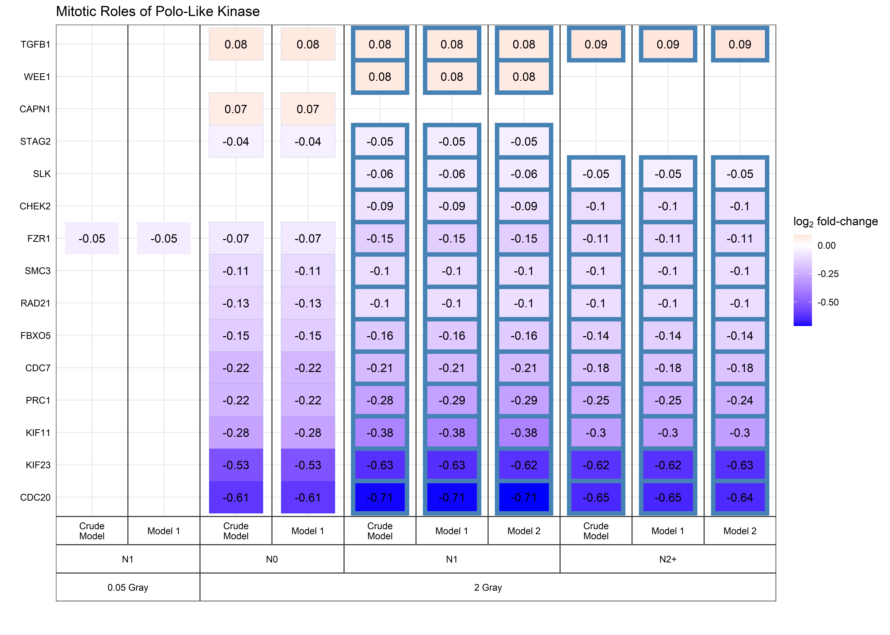
Columns with blue border: z <= -2 & adjusted p-value < 0.05 (pathway inactivated)
Model 1 considers age at sampling and sex; model 2 considers age at sampling, sex, age at and year of first diagnosis, and tumor type (not used with data from cancer-free controls). N0 = fibroblasts of cancer-free controls, N1 = fibroblasts of childhood-cancer survivors, N2+ = fibroblasts of childhood-cancer survivors with at least one second primary neoplasm.
Additional File 7a

Slide 3
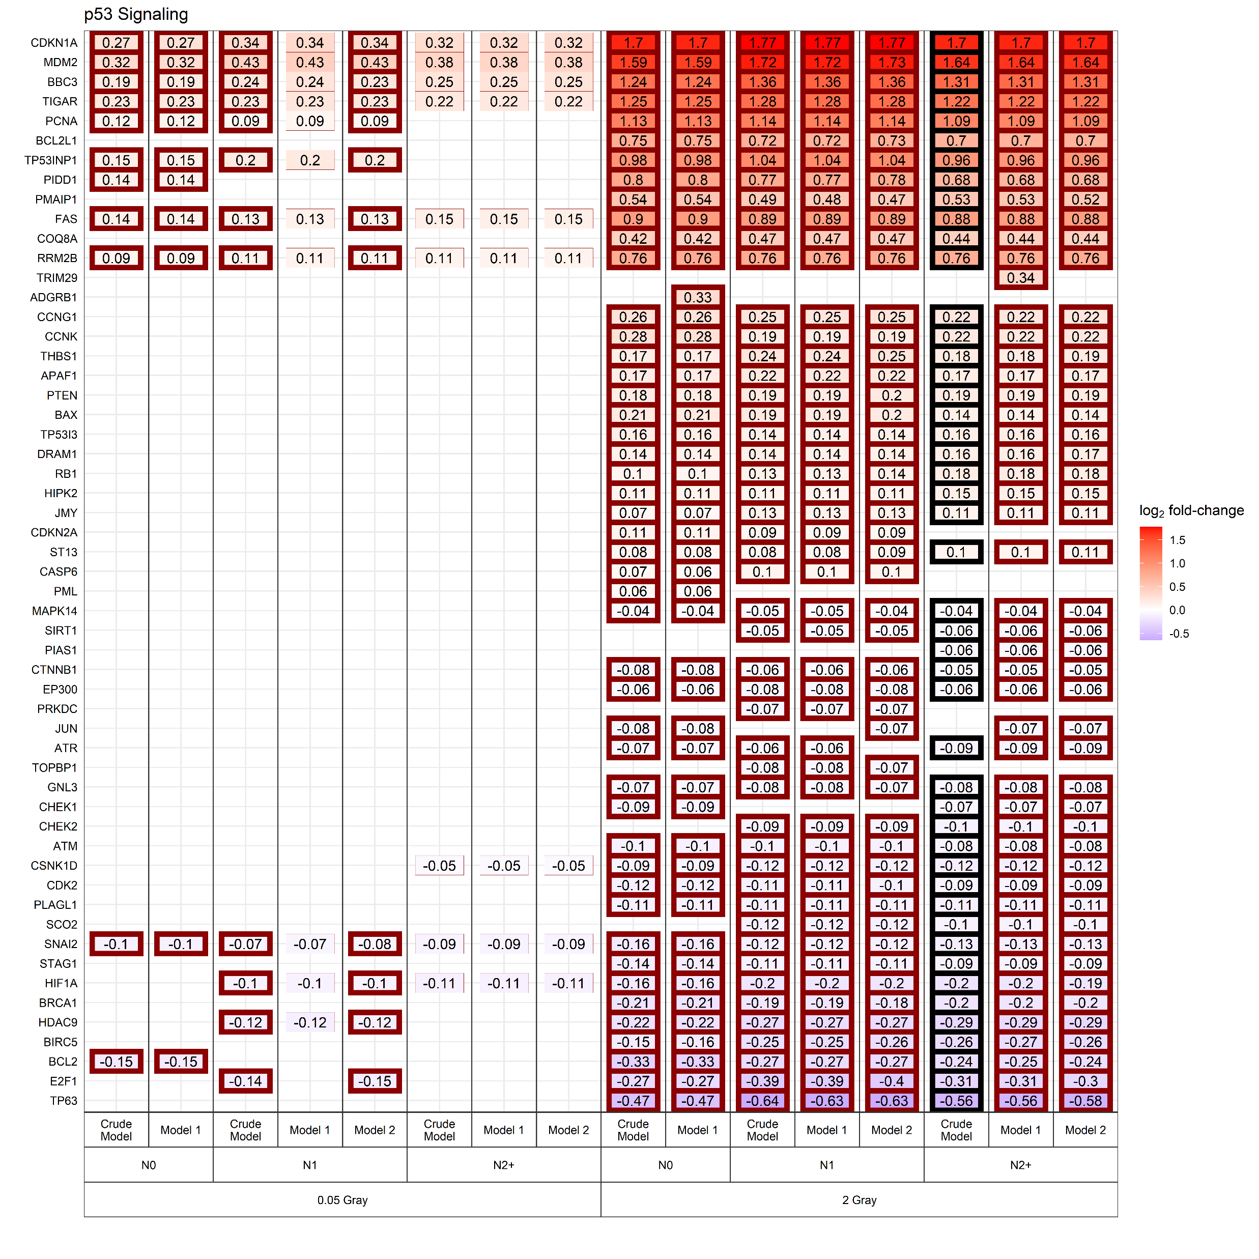
Columns with thick border: pathway affected (adjusted p-value < 0.05); Columns with red border: z >= +2 (pathway inactivated)
Model 1 considers age at sampling and sex; model 2 considers age at sampling, sex, age at and year of first diagnosis, and tumor type (not used with data from cancer-free controls). N0 = fibroblasts of cancer-free controls, N1 = fibroblasts of childhood-cancer survivors, N2+ = fibroblasts of childhood-cancer survivors with at least one second primary neoplasm.
Additional File 7b

Slide 4
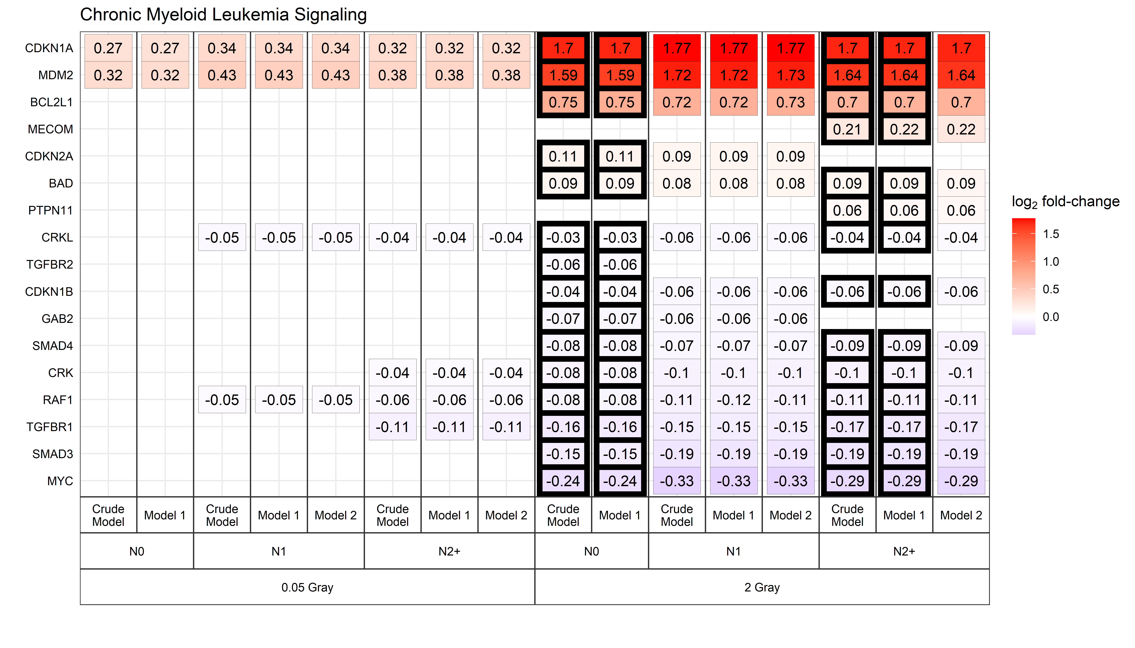
Columns with thick border: pathway affected (adjusted p-value < 0.05)
Model 1 considers age at sampling and sex; model 2 considers age at sampling, sex, age at and year of first diagnosis, and tumor type (not used with data from cancer-free controls). N0 = fibroblasts of cancer-free controls, N1 = fibroblasts of childhood-cancer survivors, N2+ = fibroblasts of childhood-cancer survivors with at least one second primary neoplasm.
Additional File 7c

Slide 5
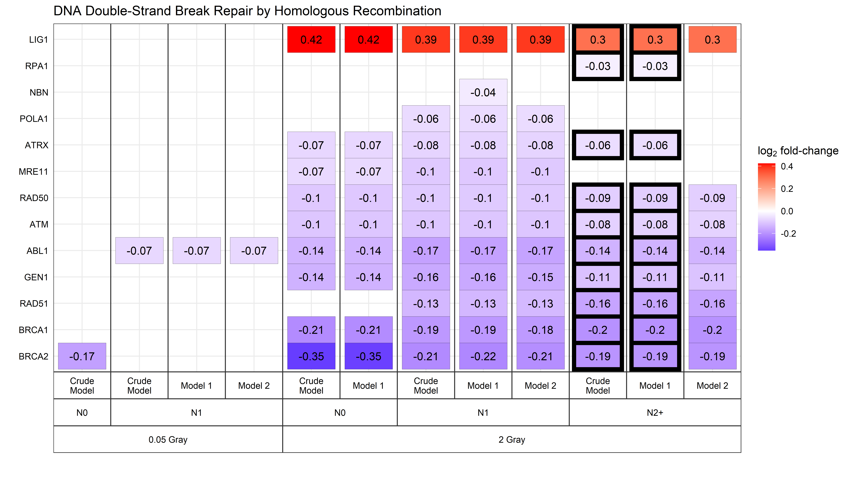
Columns with thick border: pathway affected (adjusted p-value < 0.05)
Model 1 considers age at sampling and sex; model 2 considers age at sampling, sex, age at and year of first diagnosis, and tumor type (not used with data from cancer-free controls). N0 = fibroblasts of cancer-free controls, N1 = fibroblasts of childhood-cancer survivors, N2+ = fibroblasts of childhood-cancer survivors with at least one second primary neoplasm.
Additional File 7d

Slide 6
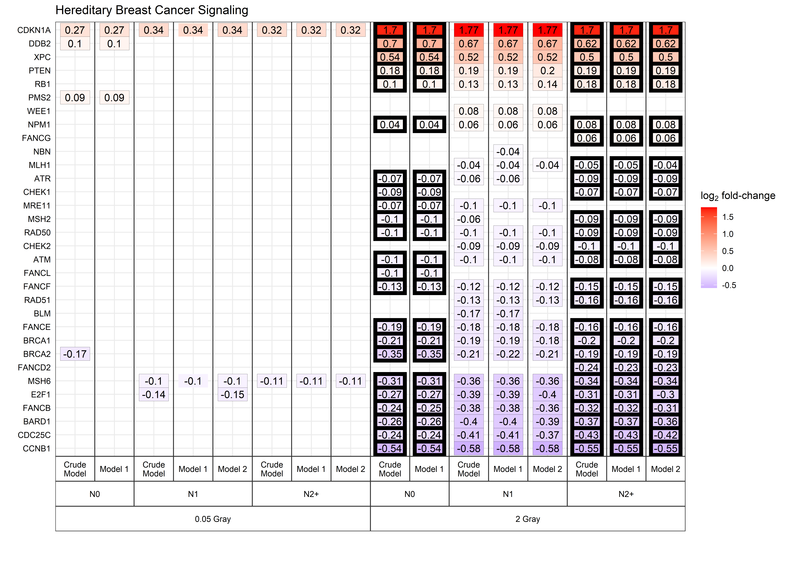
Columns with thick border: pathway affected (adjusted p-value < 0.05)
Model 1 considers age at sampling and sex; model 2 considers age at sampling, sex, age at and year of first diagnosis, and tumor type (not used with data from cancer-free controls). N0 = fibroblasts of cancer-free controls, N1 = fibroblasts of childhood-cancer survivors, N2+ = fibroblasts of childhood-cancer survivors with at least one second primary neoplasm.
Additional File 7e

Slide 7
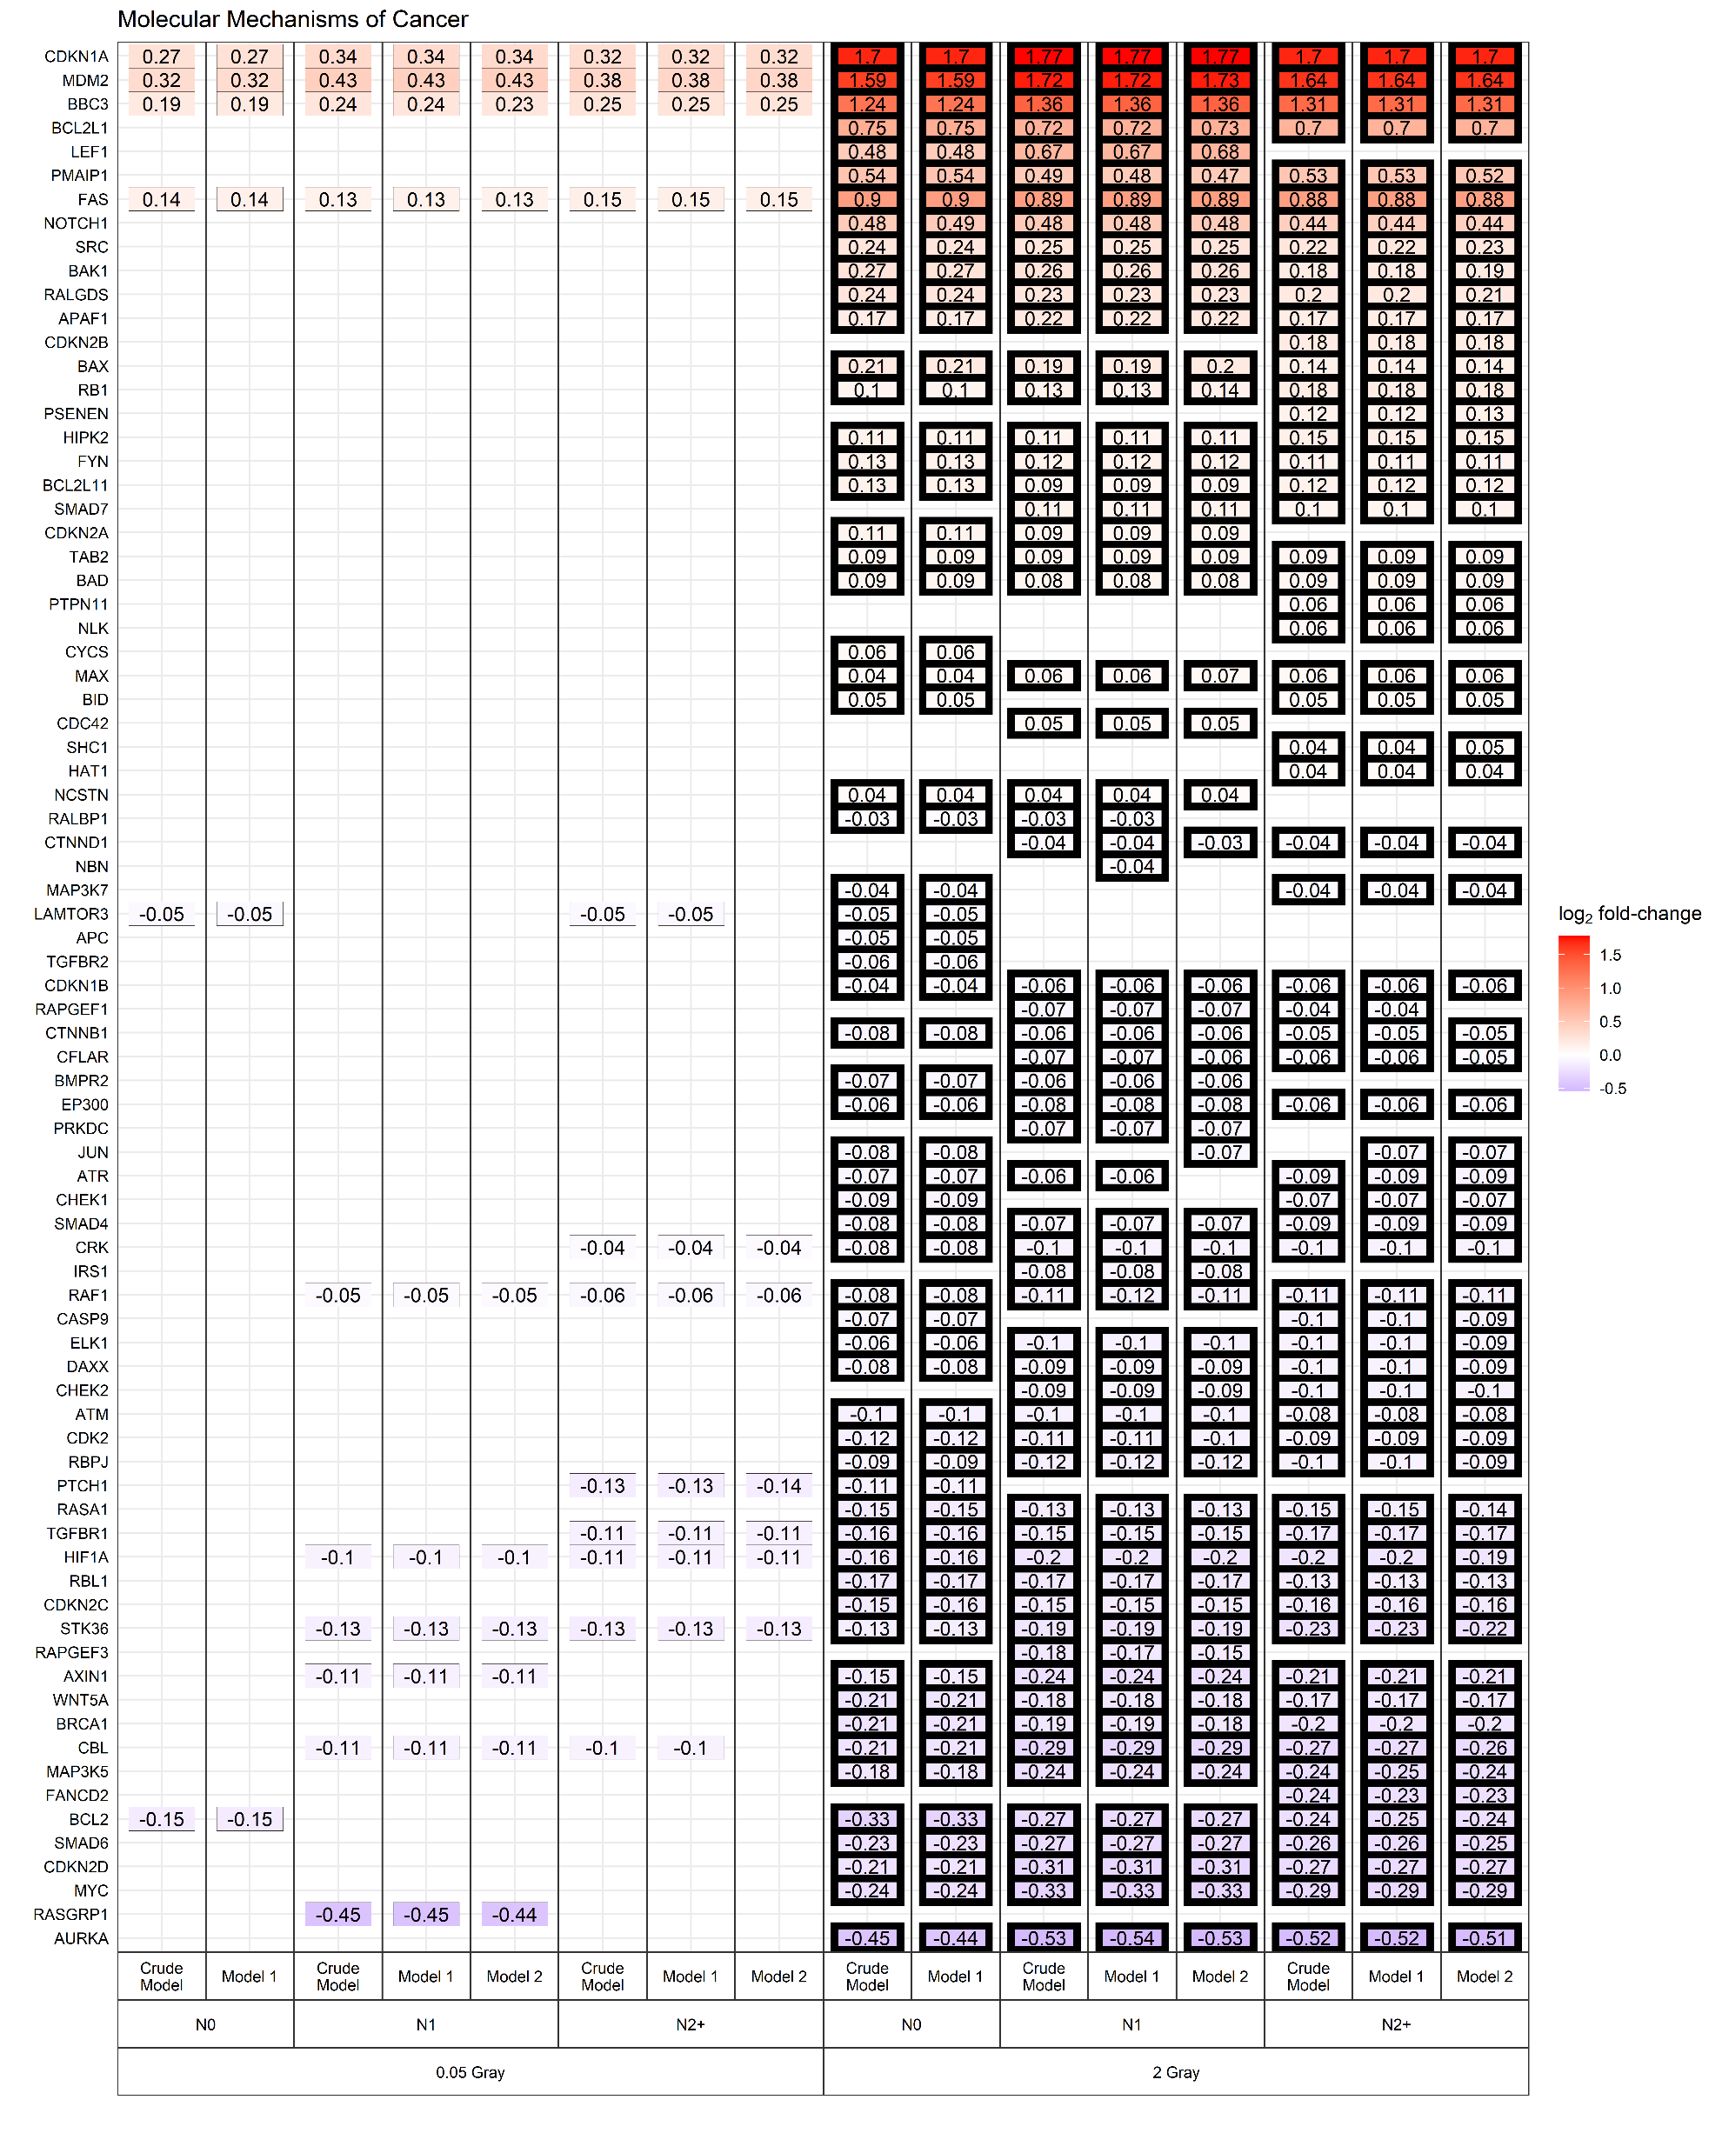
Columns with thick border: pathway affected (adjusted p-value < 0.05)
Model 1 considers age at sampling and sex; model 2 considers age at sampling, sex, age at and year of first diagnosis, and tumor type (not used with data from cancer-free controls). N0 = fibroblasts of cancer-free controls, N1 = fibroblasts of childhood-cancer survivors, N2+ = fibroblasts of childhood-cancer survivors with at least one second primary neoplasm.
Additional File 7f

Slide 8
Columns with thick border: pathway affected (adjusted p-value < 0.05)
Model 1 considers age at sampling and sex; model 2 considers age at sampling, sex, age at and year of first diagnosis, and tumor type (not used with data from cancer-free controls). N0 = fibroblasts of cancer-free controls, N1 = fibroblasts of childhood-cancer survivors, N2+ = fibroblasts of childhood-cancer survivors with at least one second primary neoplasm.
Additional File 7g

