Slide 1
Additional File 8
Molecule activity prediction using Ingenuity Pathway Analysis

Slide 2
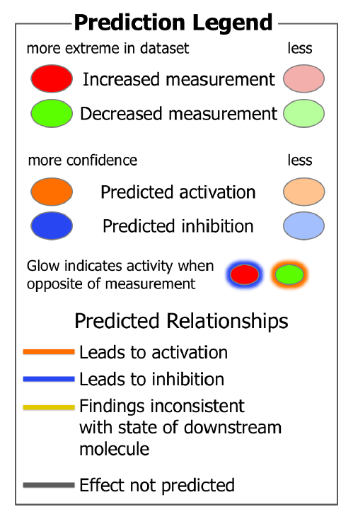

Slide 3
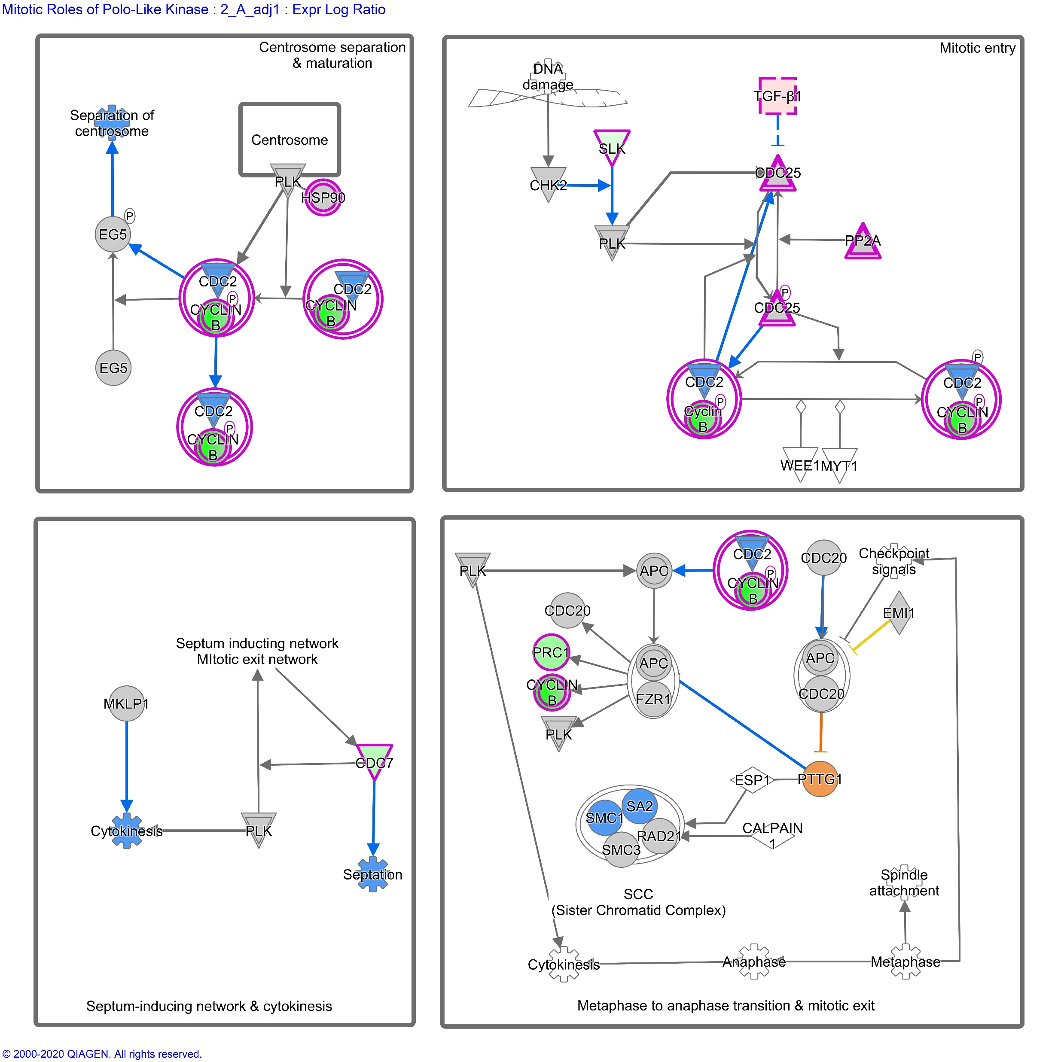

Additional File 8a
Molecule activity prediction using Ingenuity Pathway Analysis. Mitotic Roles of Polo-Like Kinase after 2 Gray, model 1 (considering age at sampling and sex). Left: fibroblasts of donors with at least one second primary neoplasm, right: childhood cancer survivors without a second primary neoplasm

Slide 4
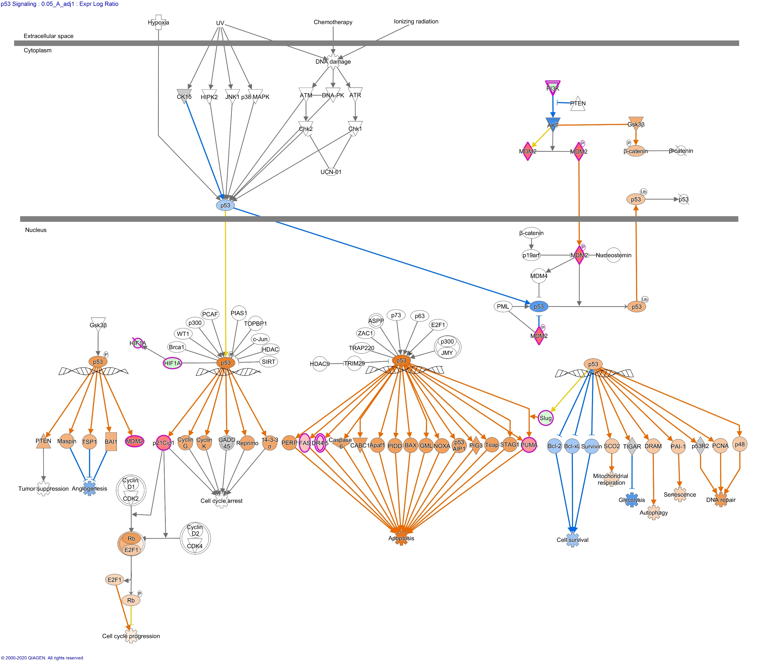
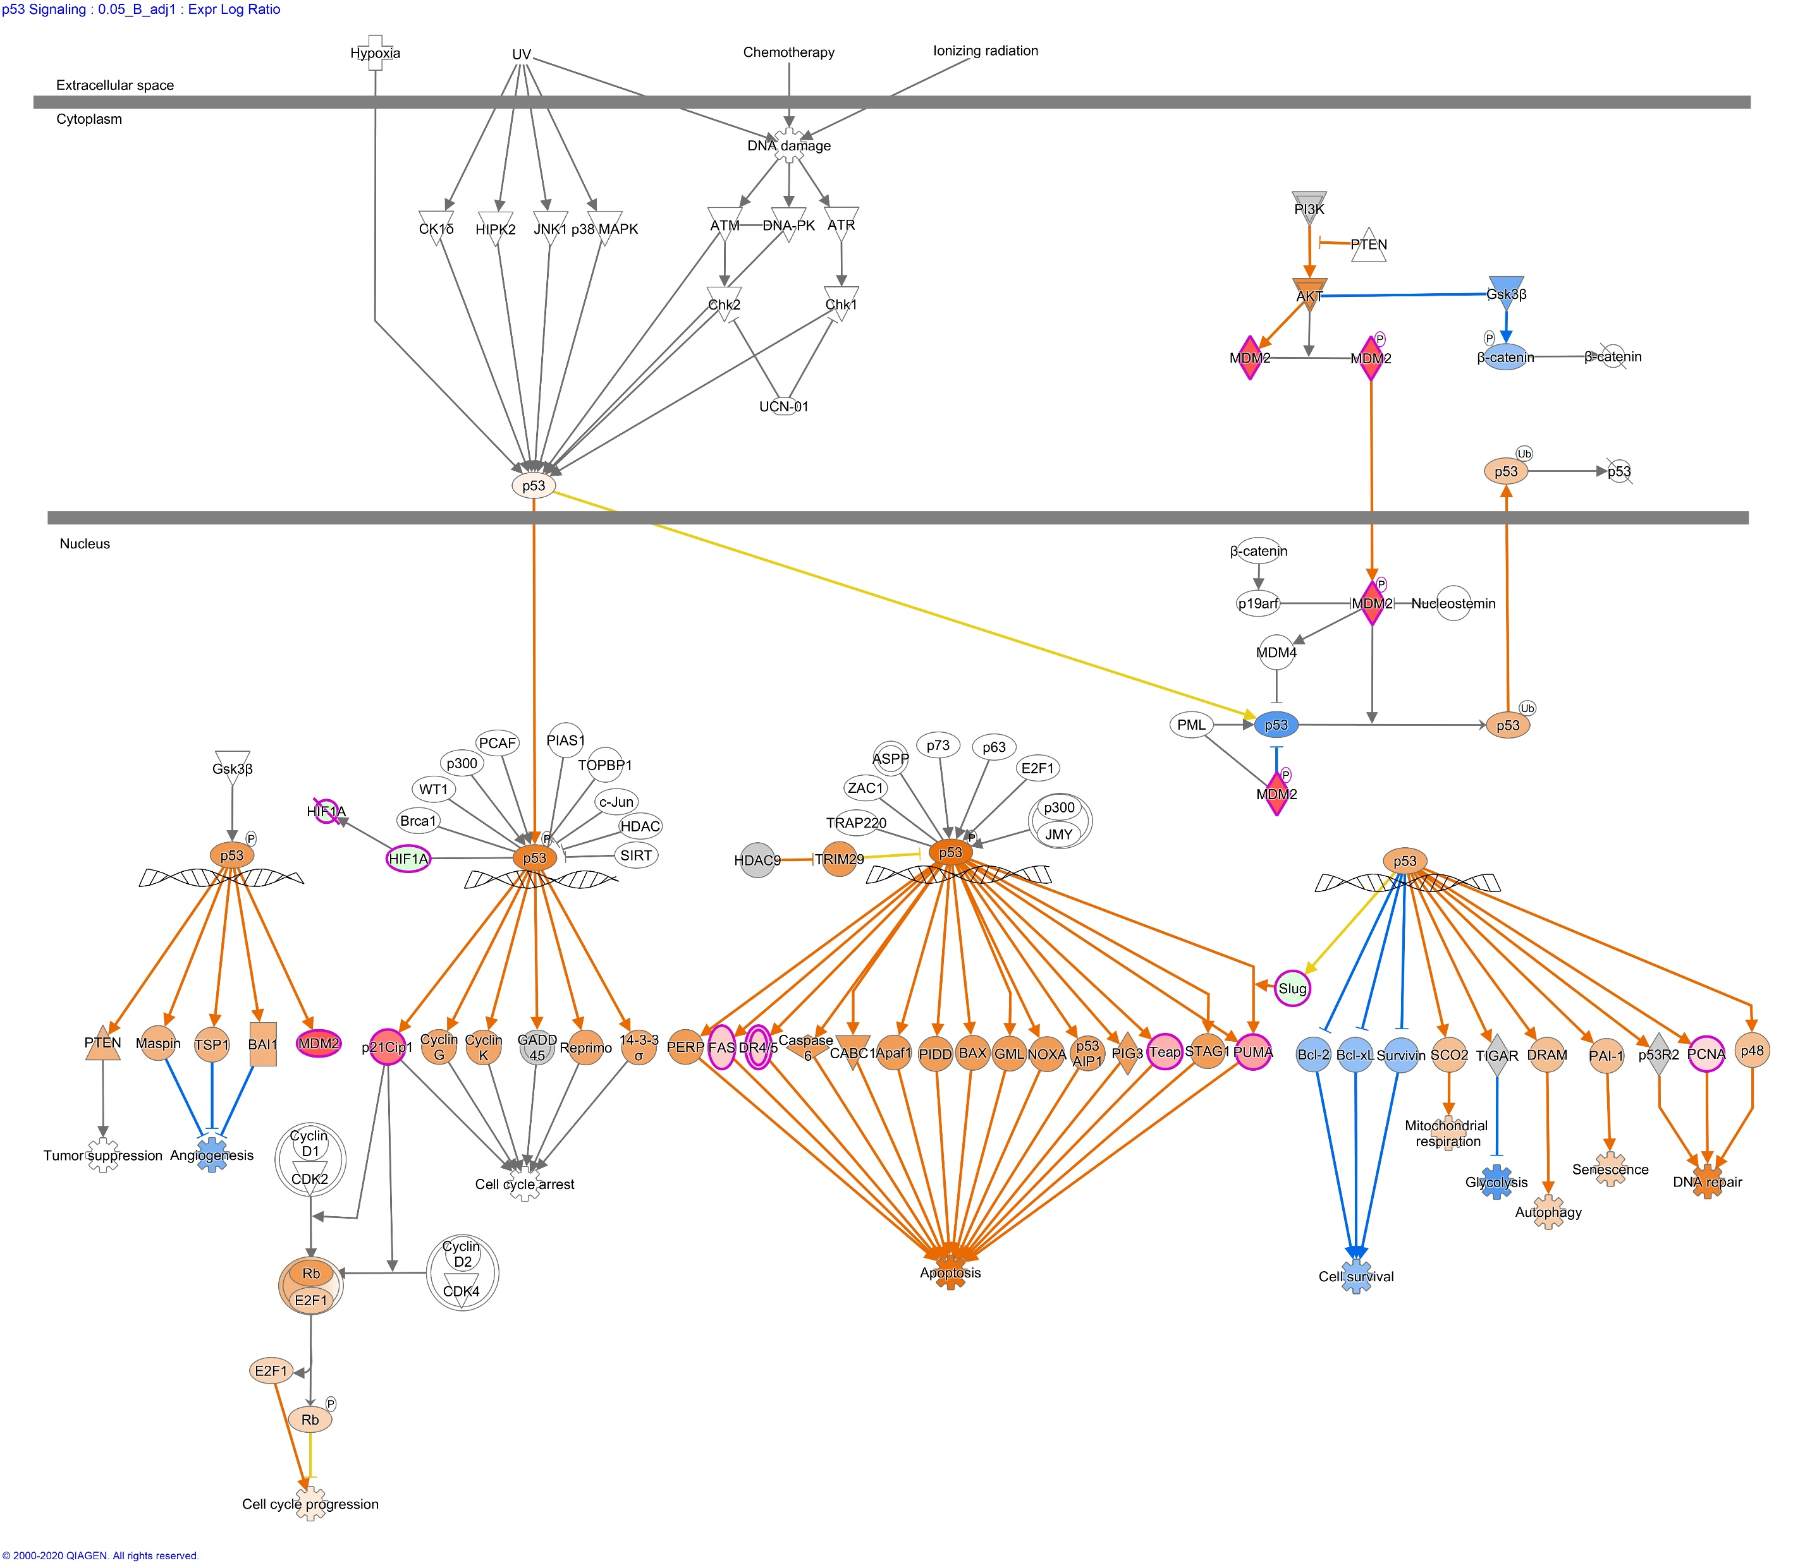
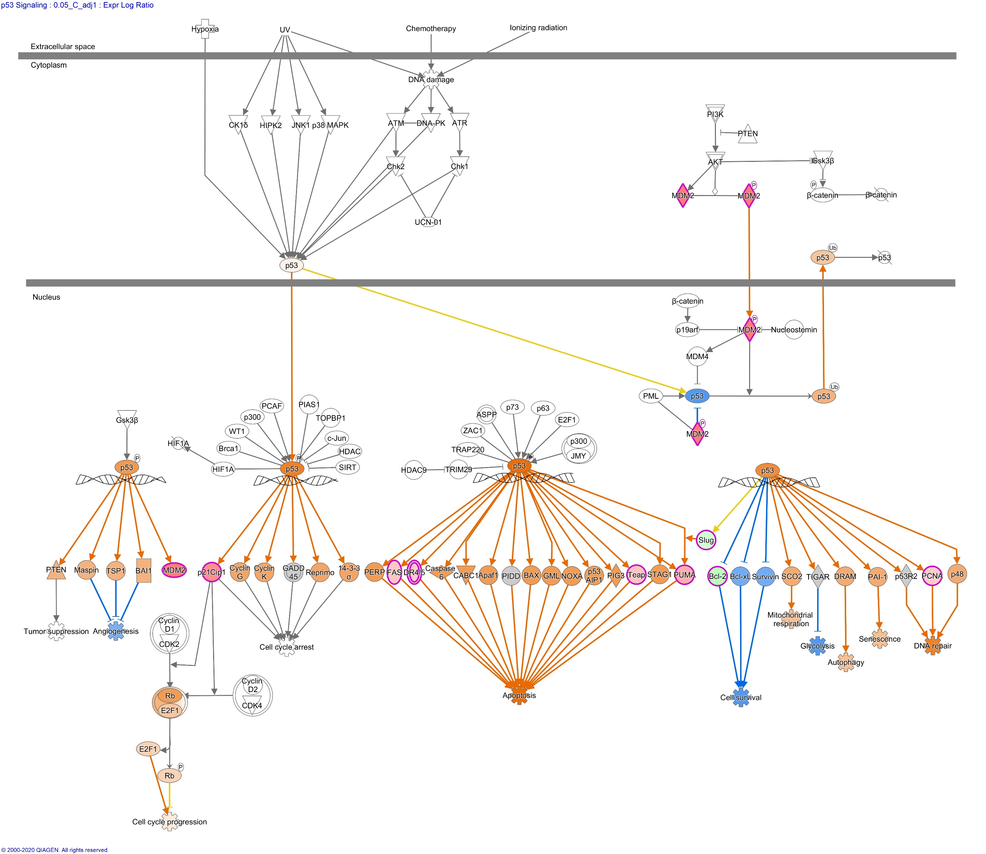
Additional File 8b
Molecule activity prediction using Ingenuity Pathway Analysis. p53 Signaling after 0.05 Gray, model 1 (considering age at sampling and sex). Left to right: fibroblasts of donors with at least one second primary neoplasm, childhood cancer survivors, and cancer-free donors. (Only adjusted p-value < 0.05 in fibroblasts of cancer-free donors)

Slide 5
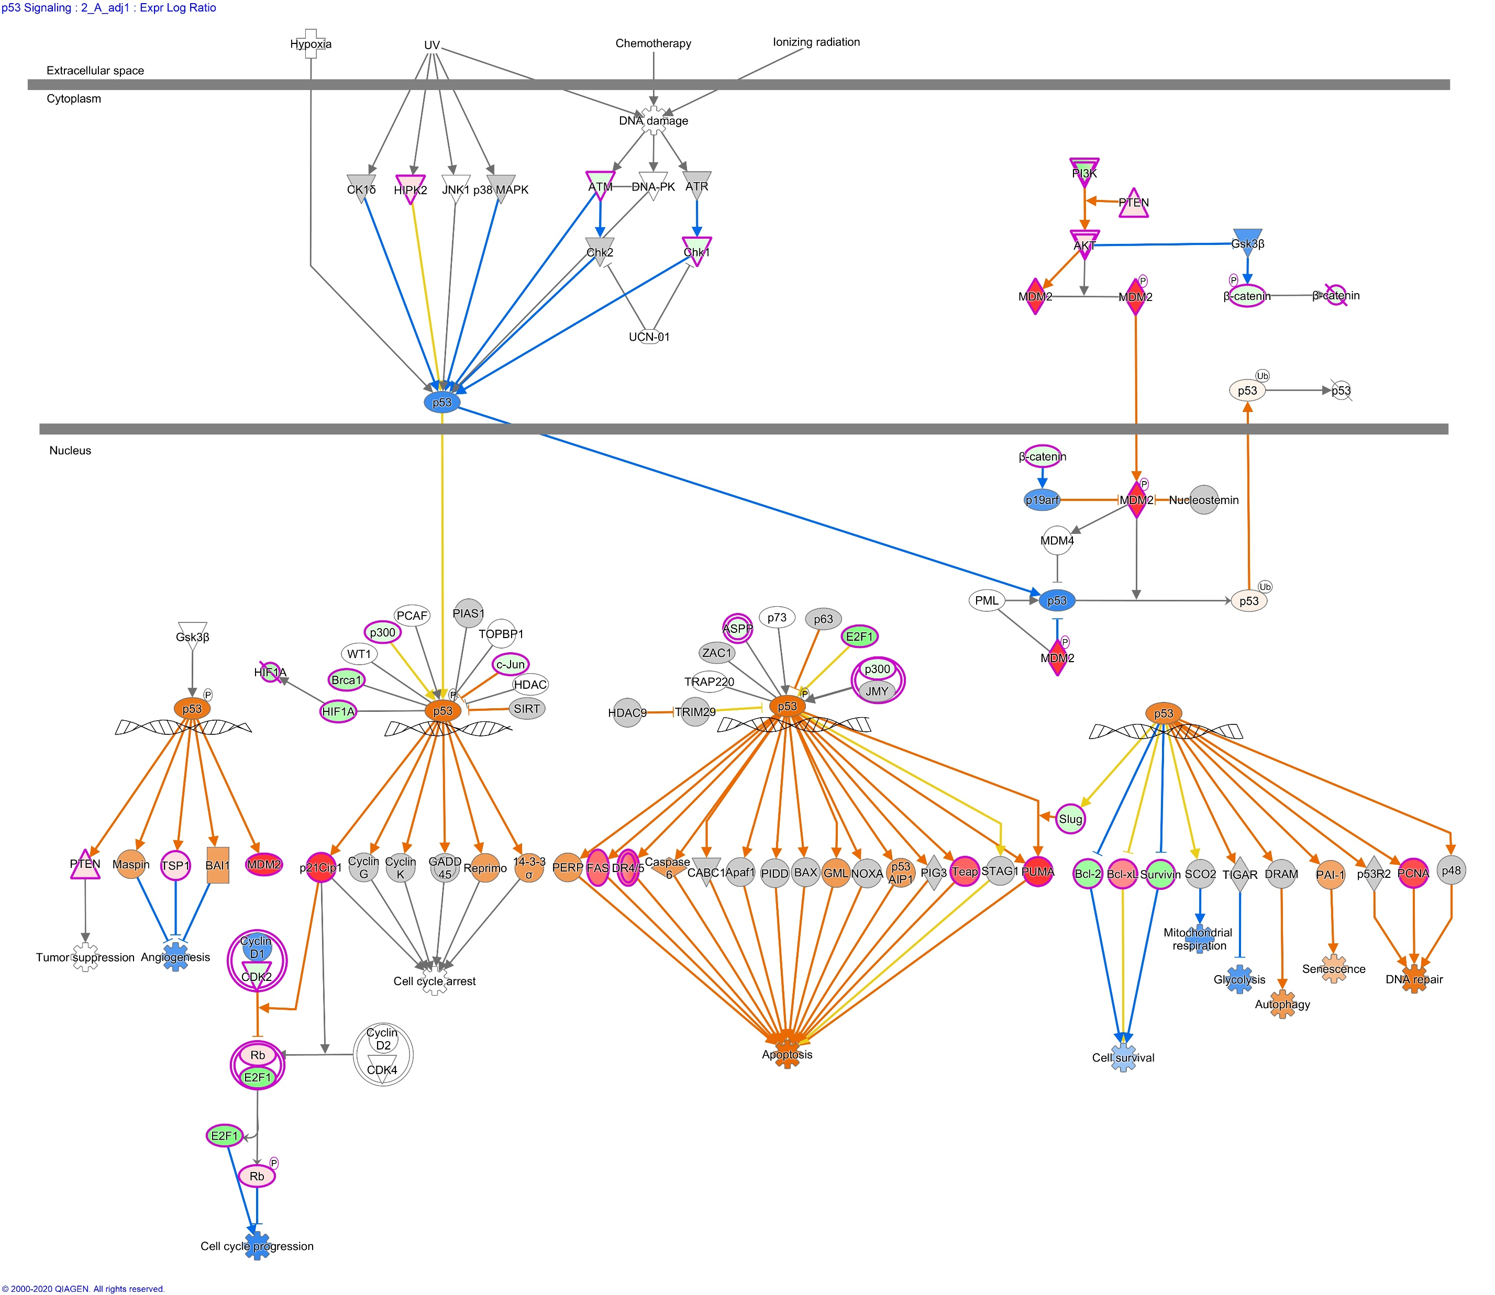
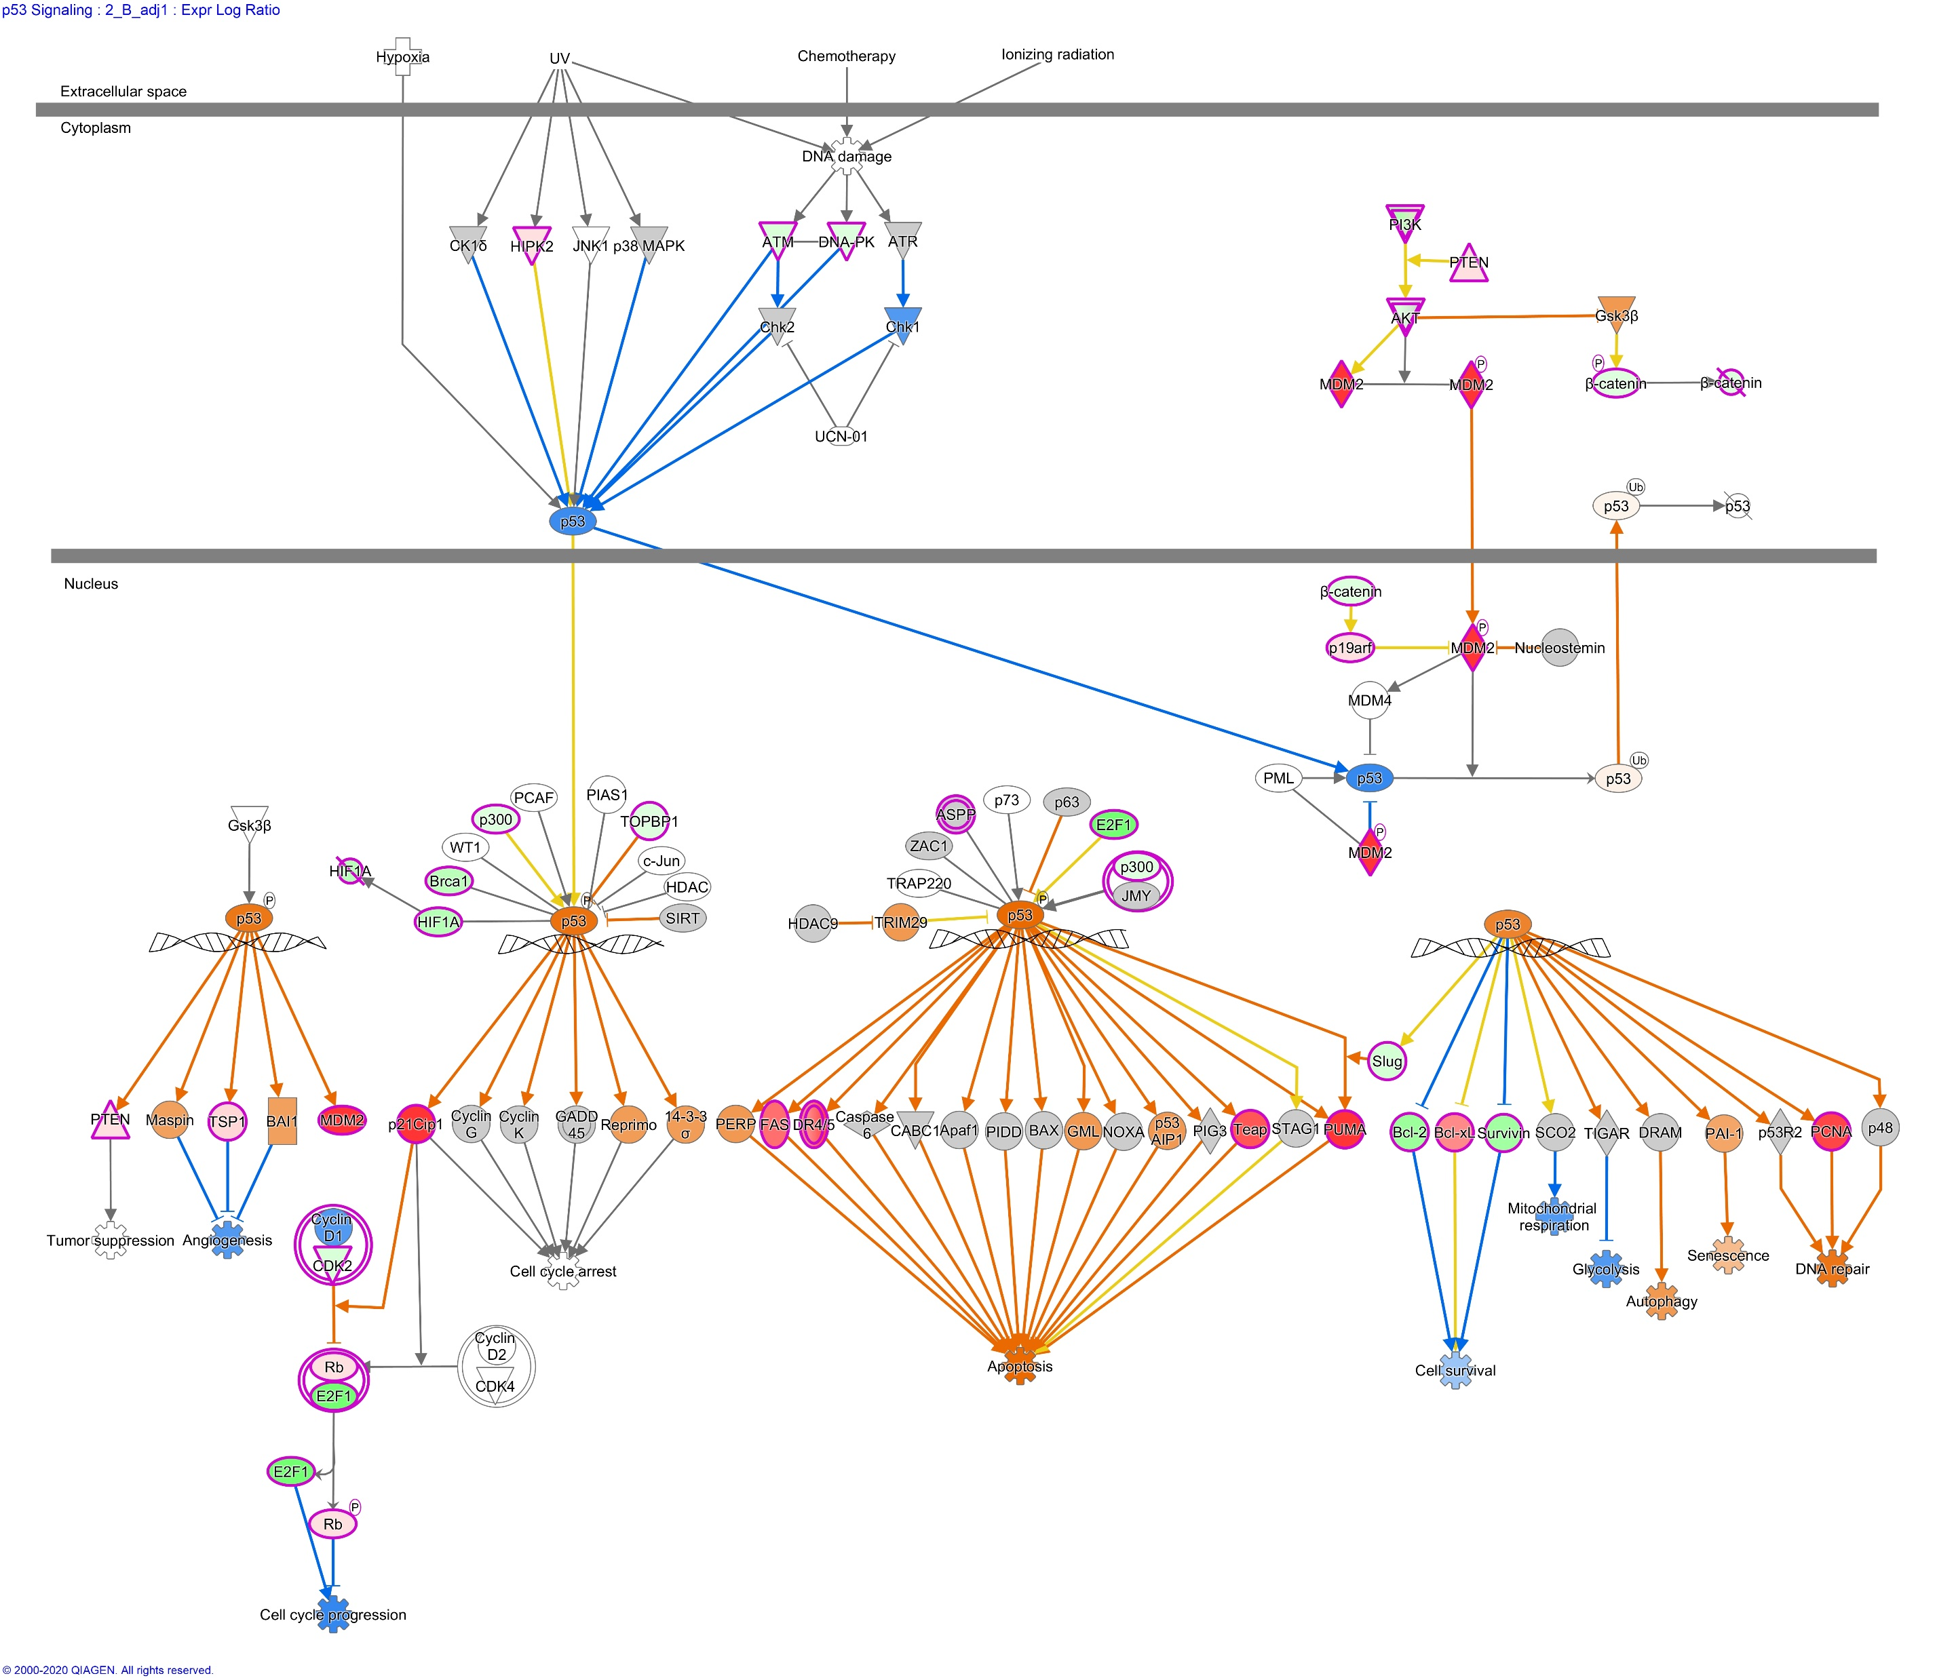
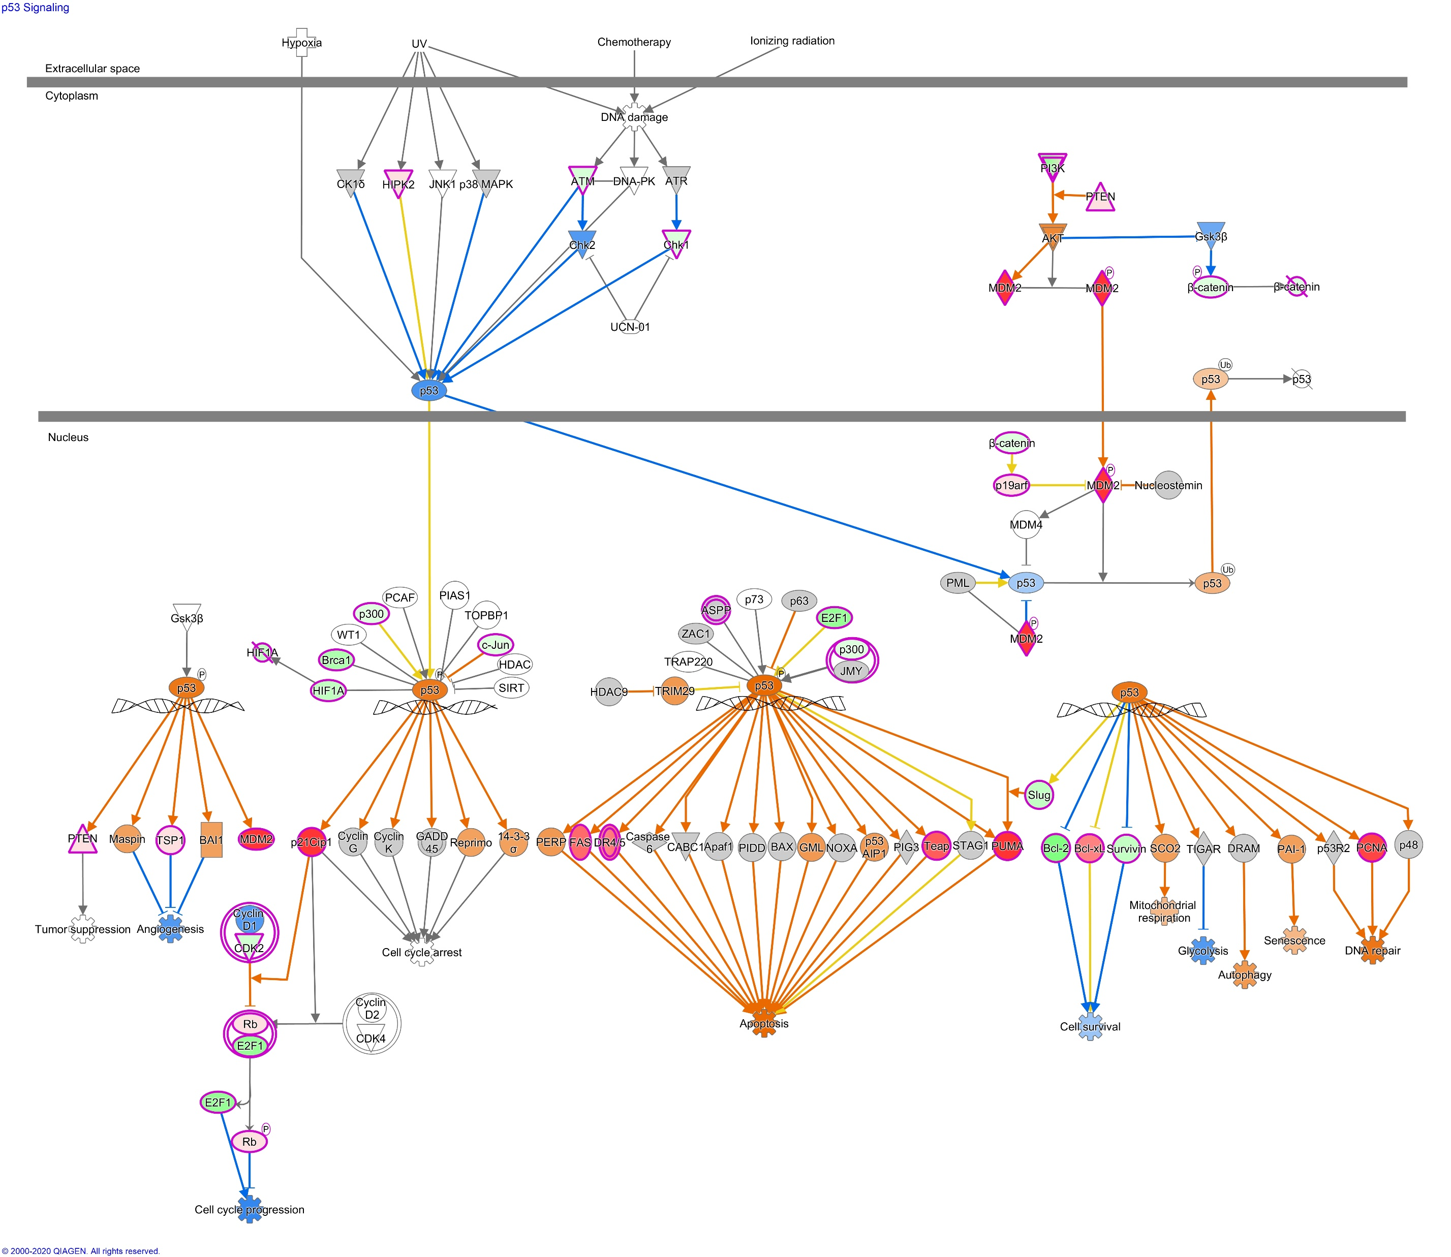
Additional File 8c
Molecule activity prediction using Ingenuity Pathway Analysis. p53 Signaling after 2 Gray, model 1 (considering age at sampling and sex). Left to right: fibroblasts of donors with at least one second primary neoplasm, childhood cancer survivors, cancer-free controls

Slide 6
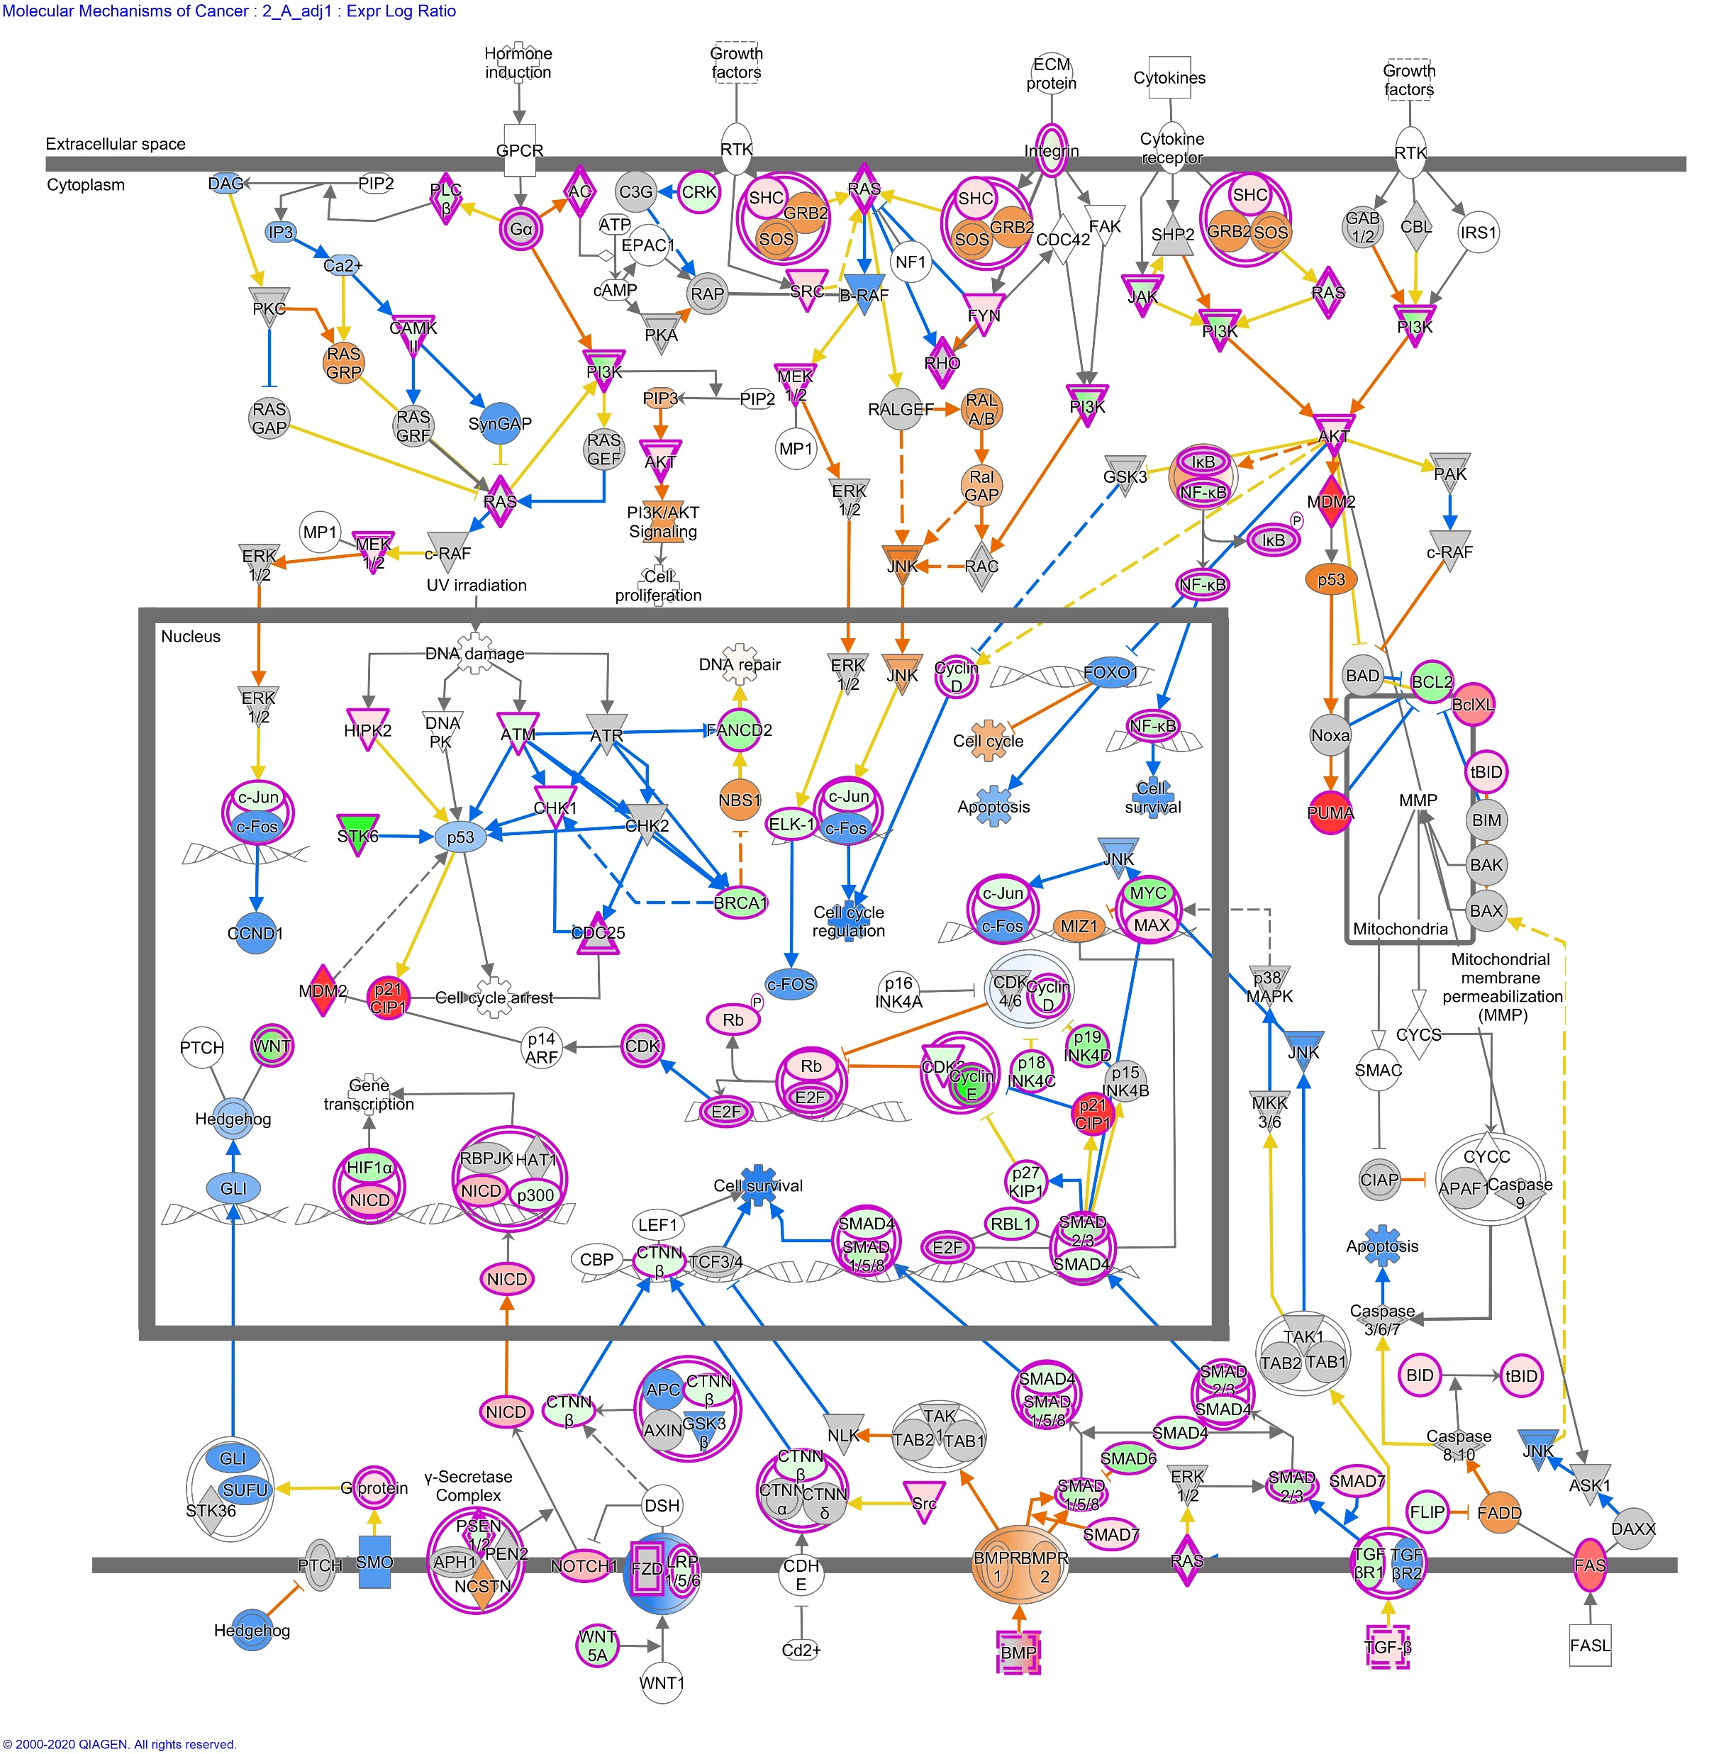
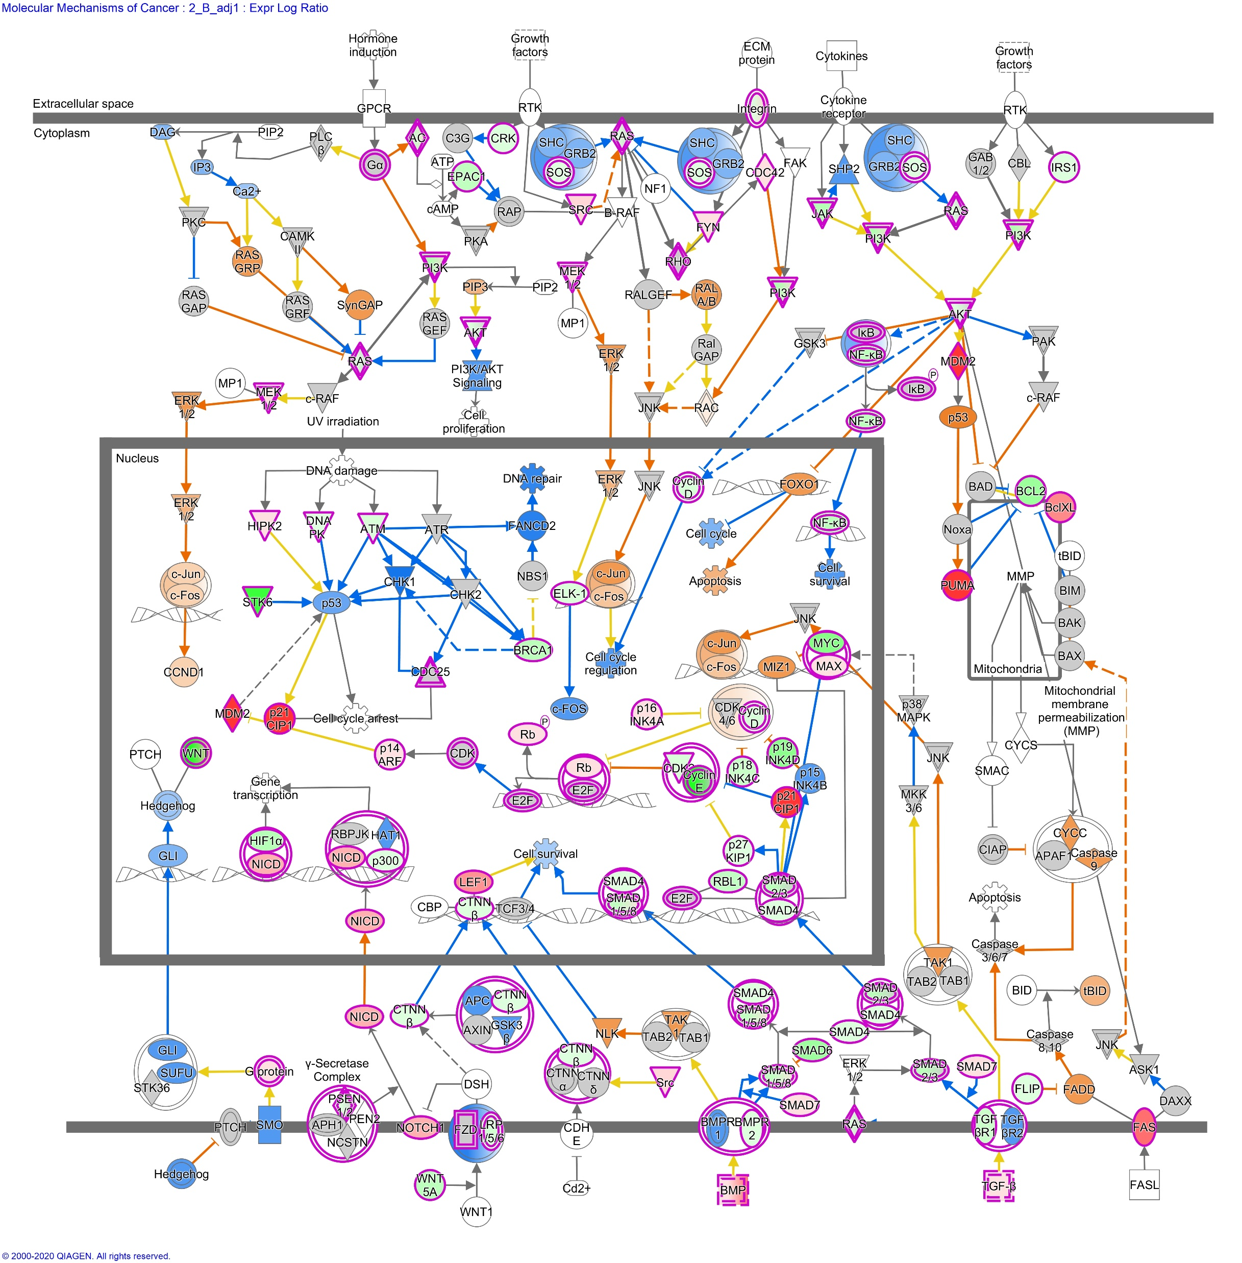
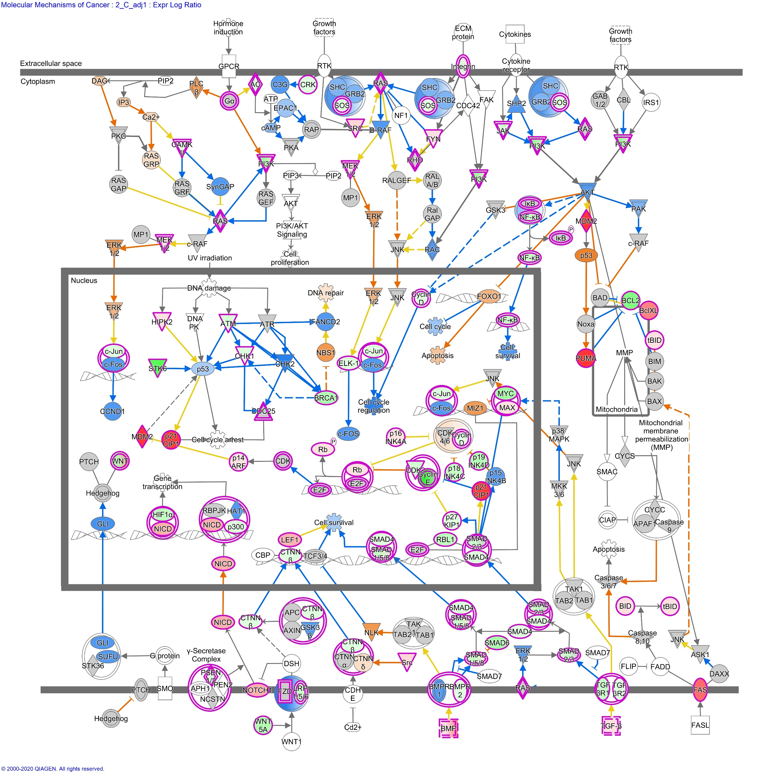
Additional File 8d
Molecule activity prediction using Ingenuity Pathway Analysis. Molecular Mechanisms of Cancer after 2 Gray, model 1 (considering age at sampling and sex). Left to right: in fibroblasts of donors with at least one second primary neoplasm, childhood cancer survivors, cancer-free controls.

Slide 7
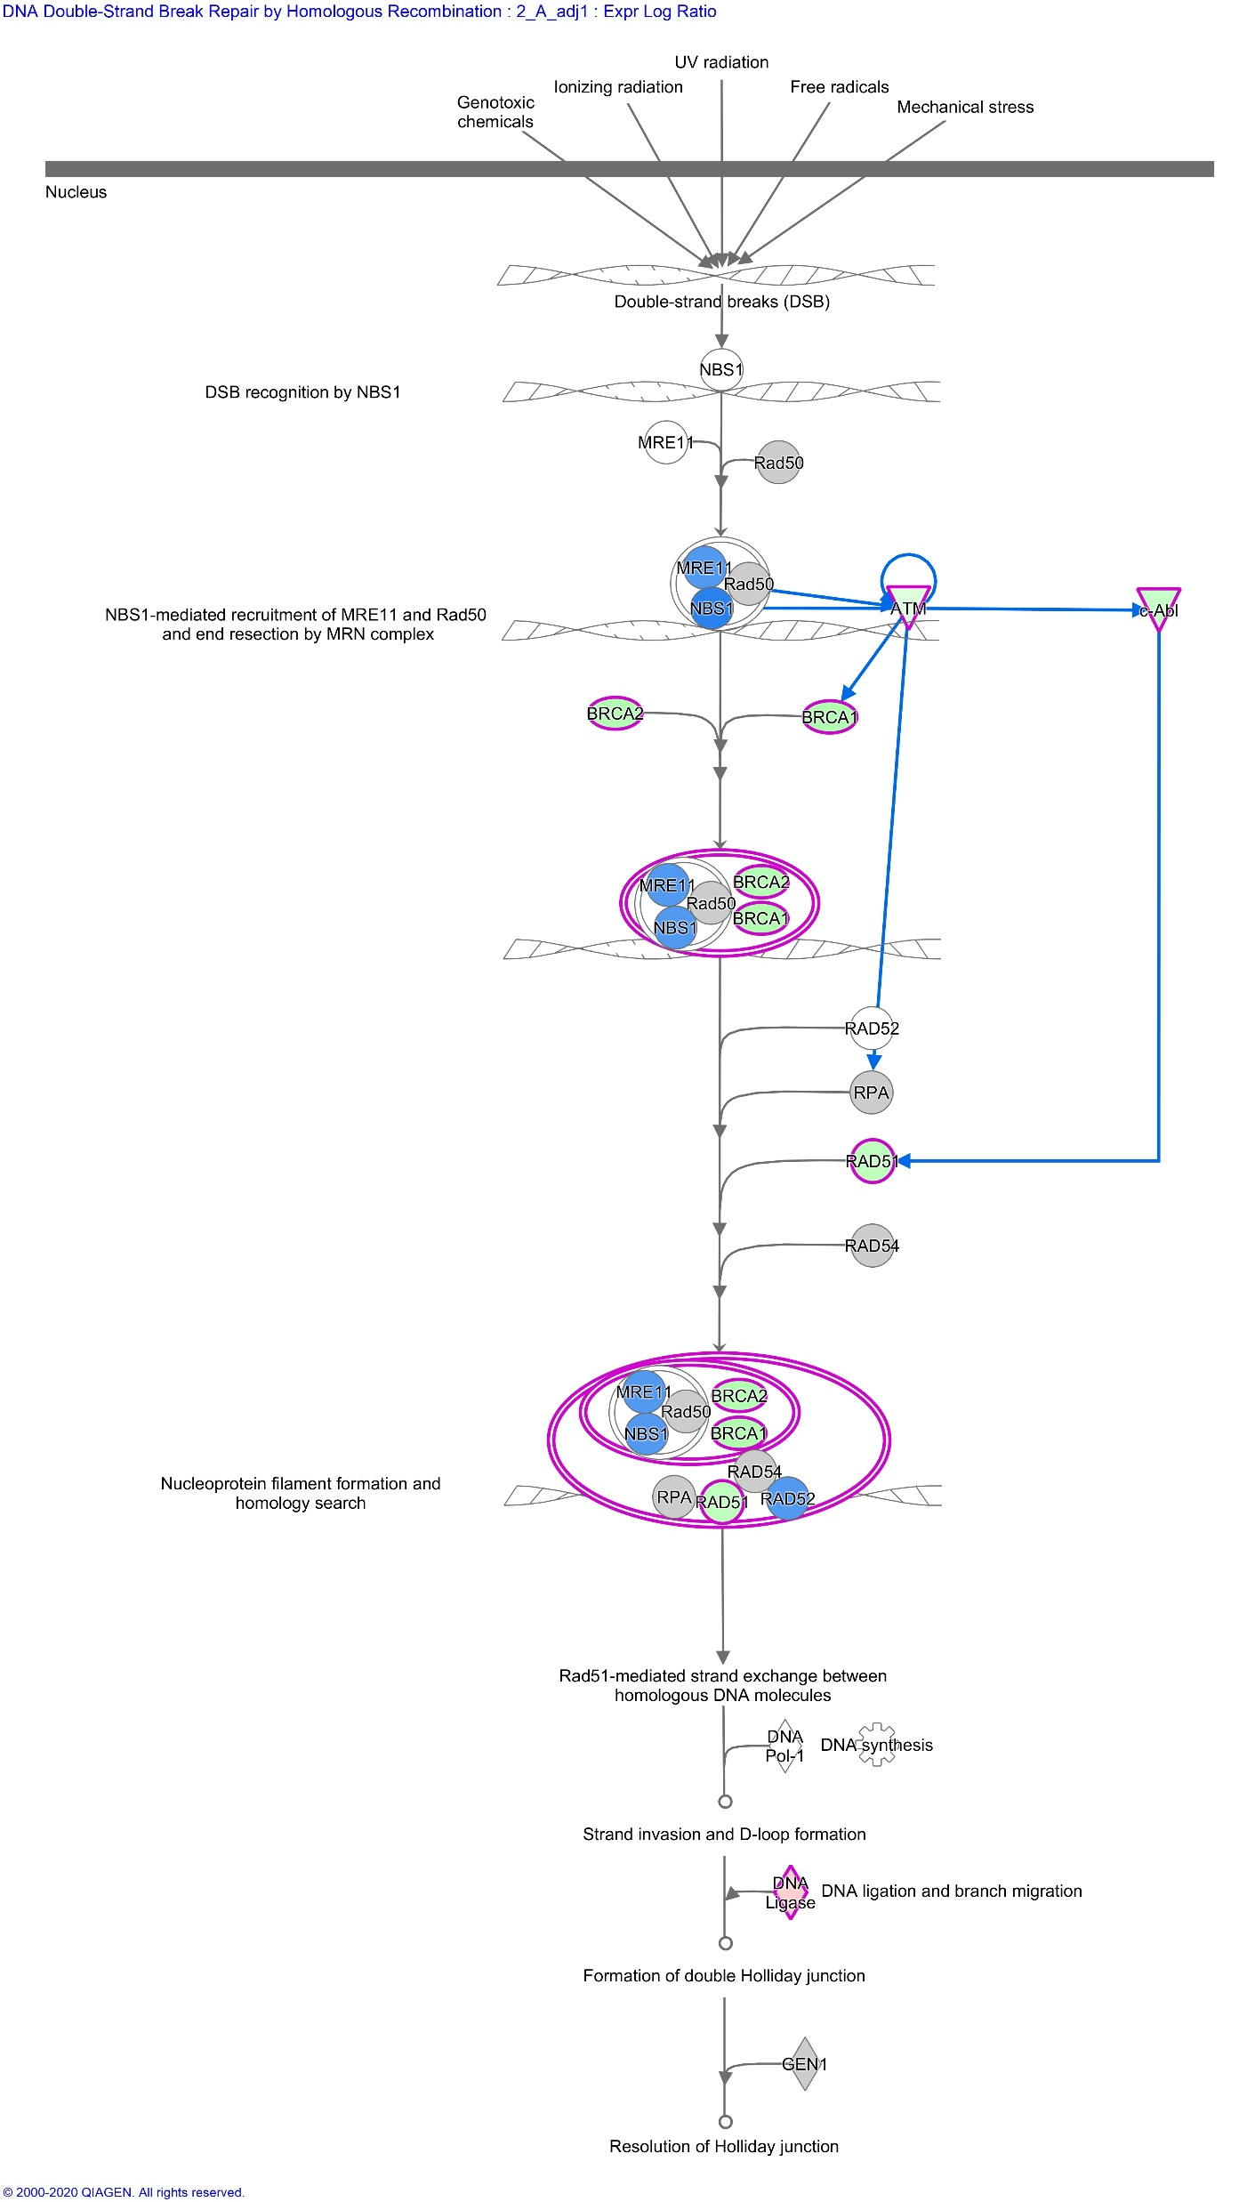
Additional File 8e
Molecule activity prediction using Ingenuity Pathway Analysis. DNA Double-Strand Break Repair by Homologous Recombination after 2 Gray, model 1 (considering age at sampling and sex) in fibroblasts of donors with at least one second primary neoplasm.

Slide 8
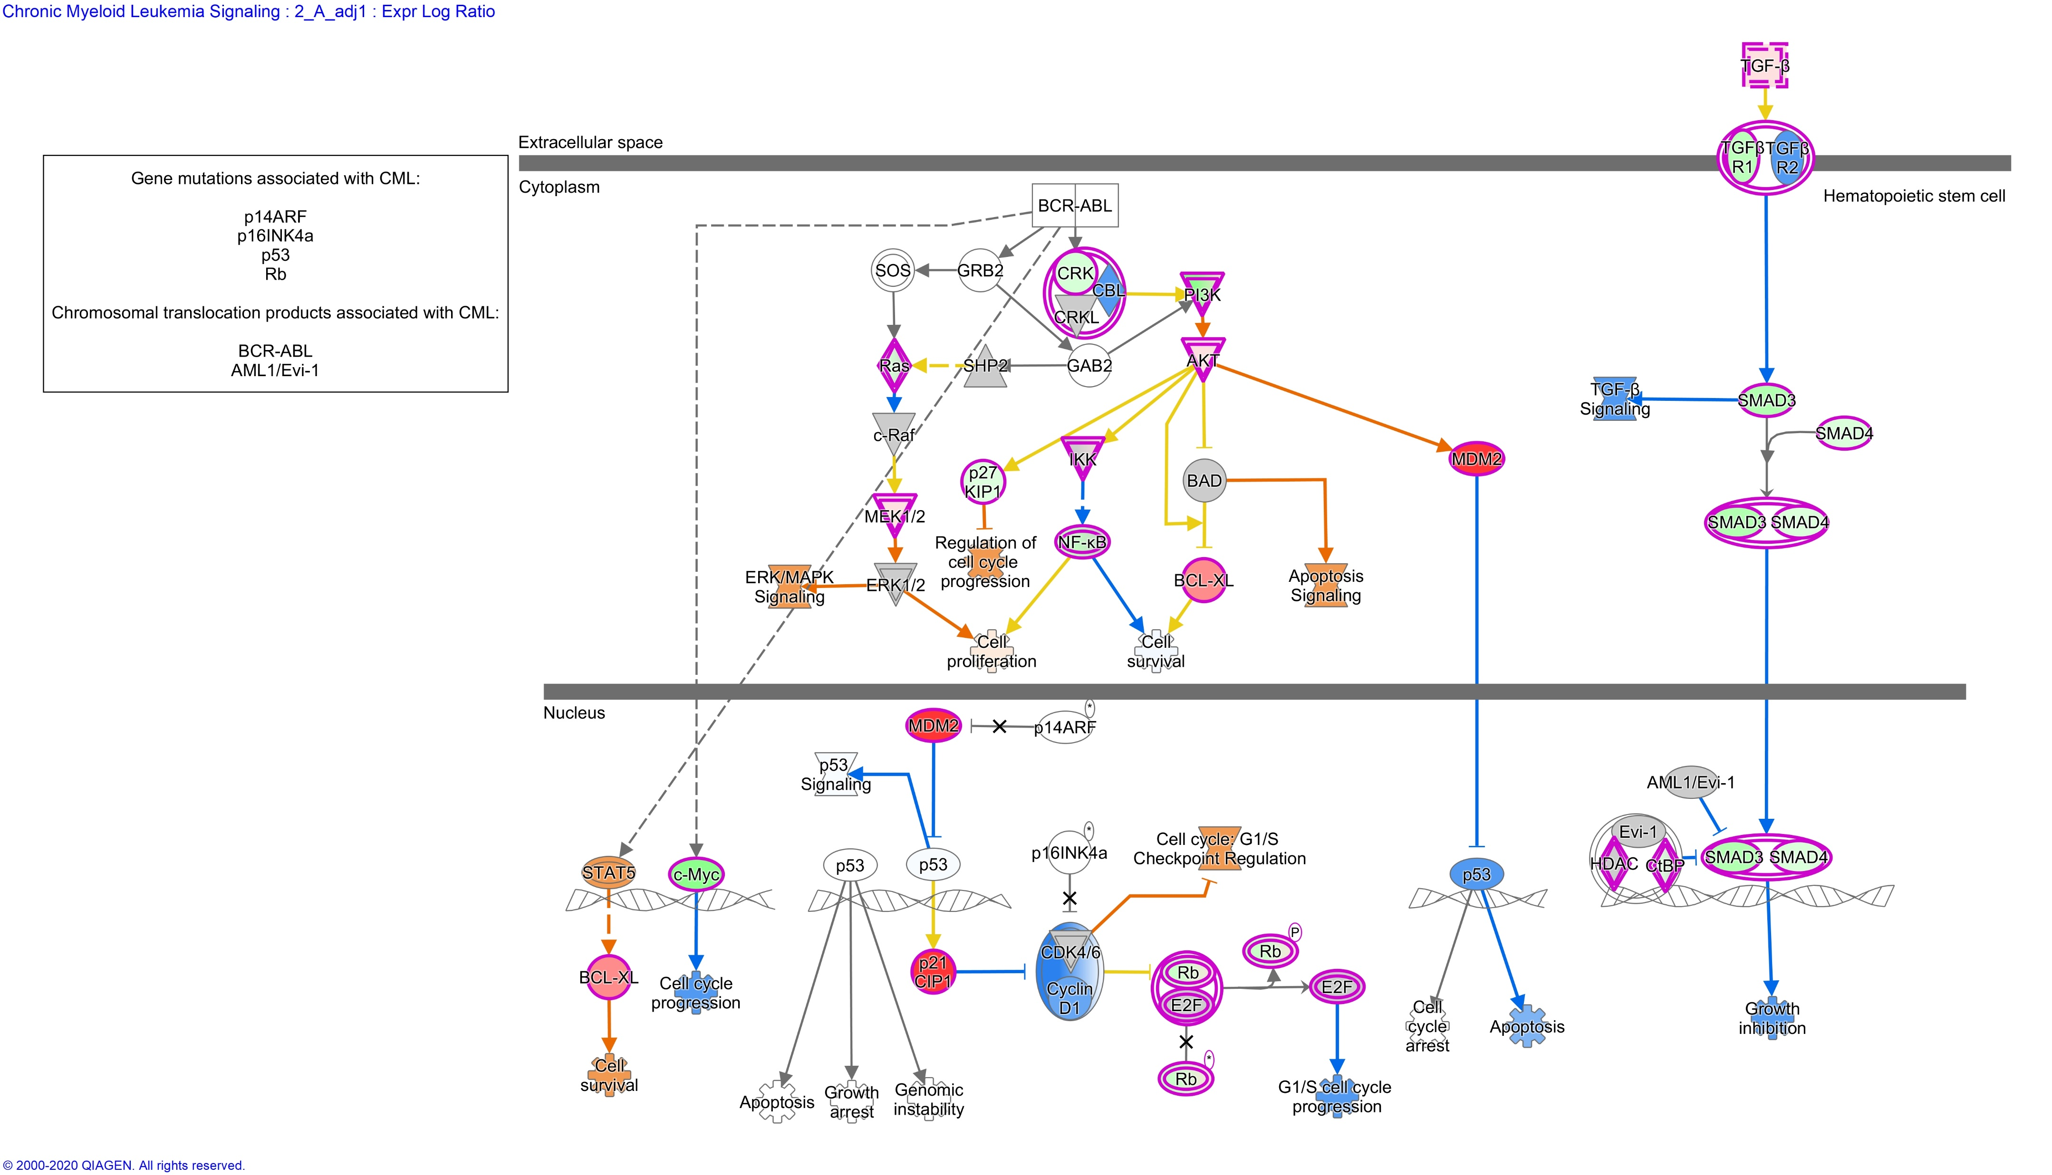
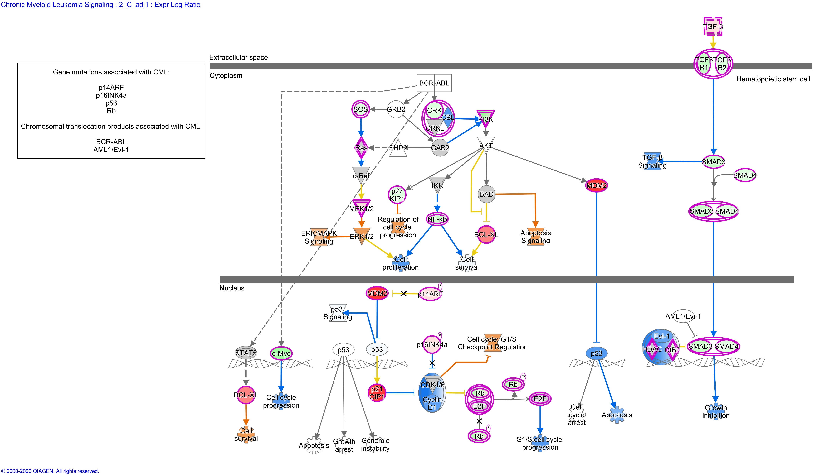
Additional File 8f
Molecule activity prediction using Ingenuity Pathway Analysis. Chronic Myeloid Leukemia Signaling after 2 Gray, model 1 (considering age at sampling and sex) in fibroblasts of donors with at least one second primary neoplasm (left) and cancer-free controls (right).

Slide 9
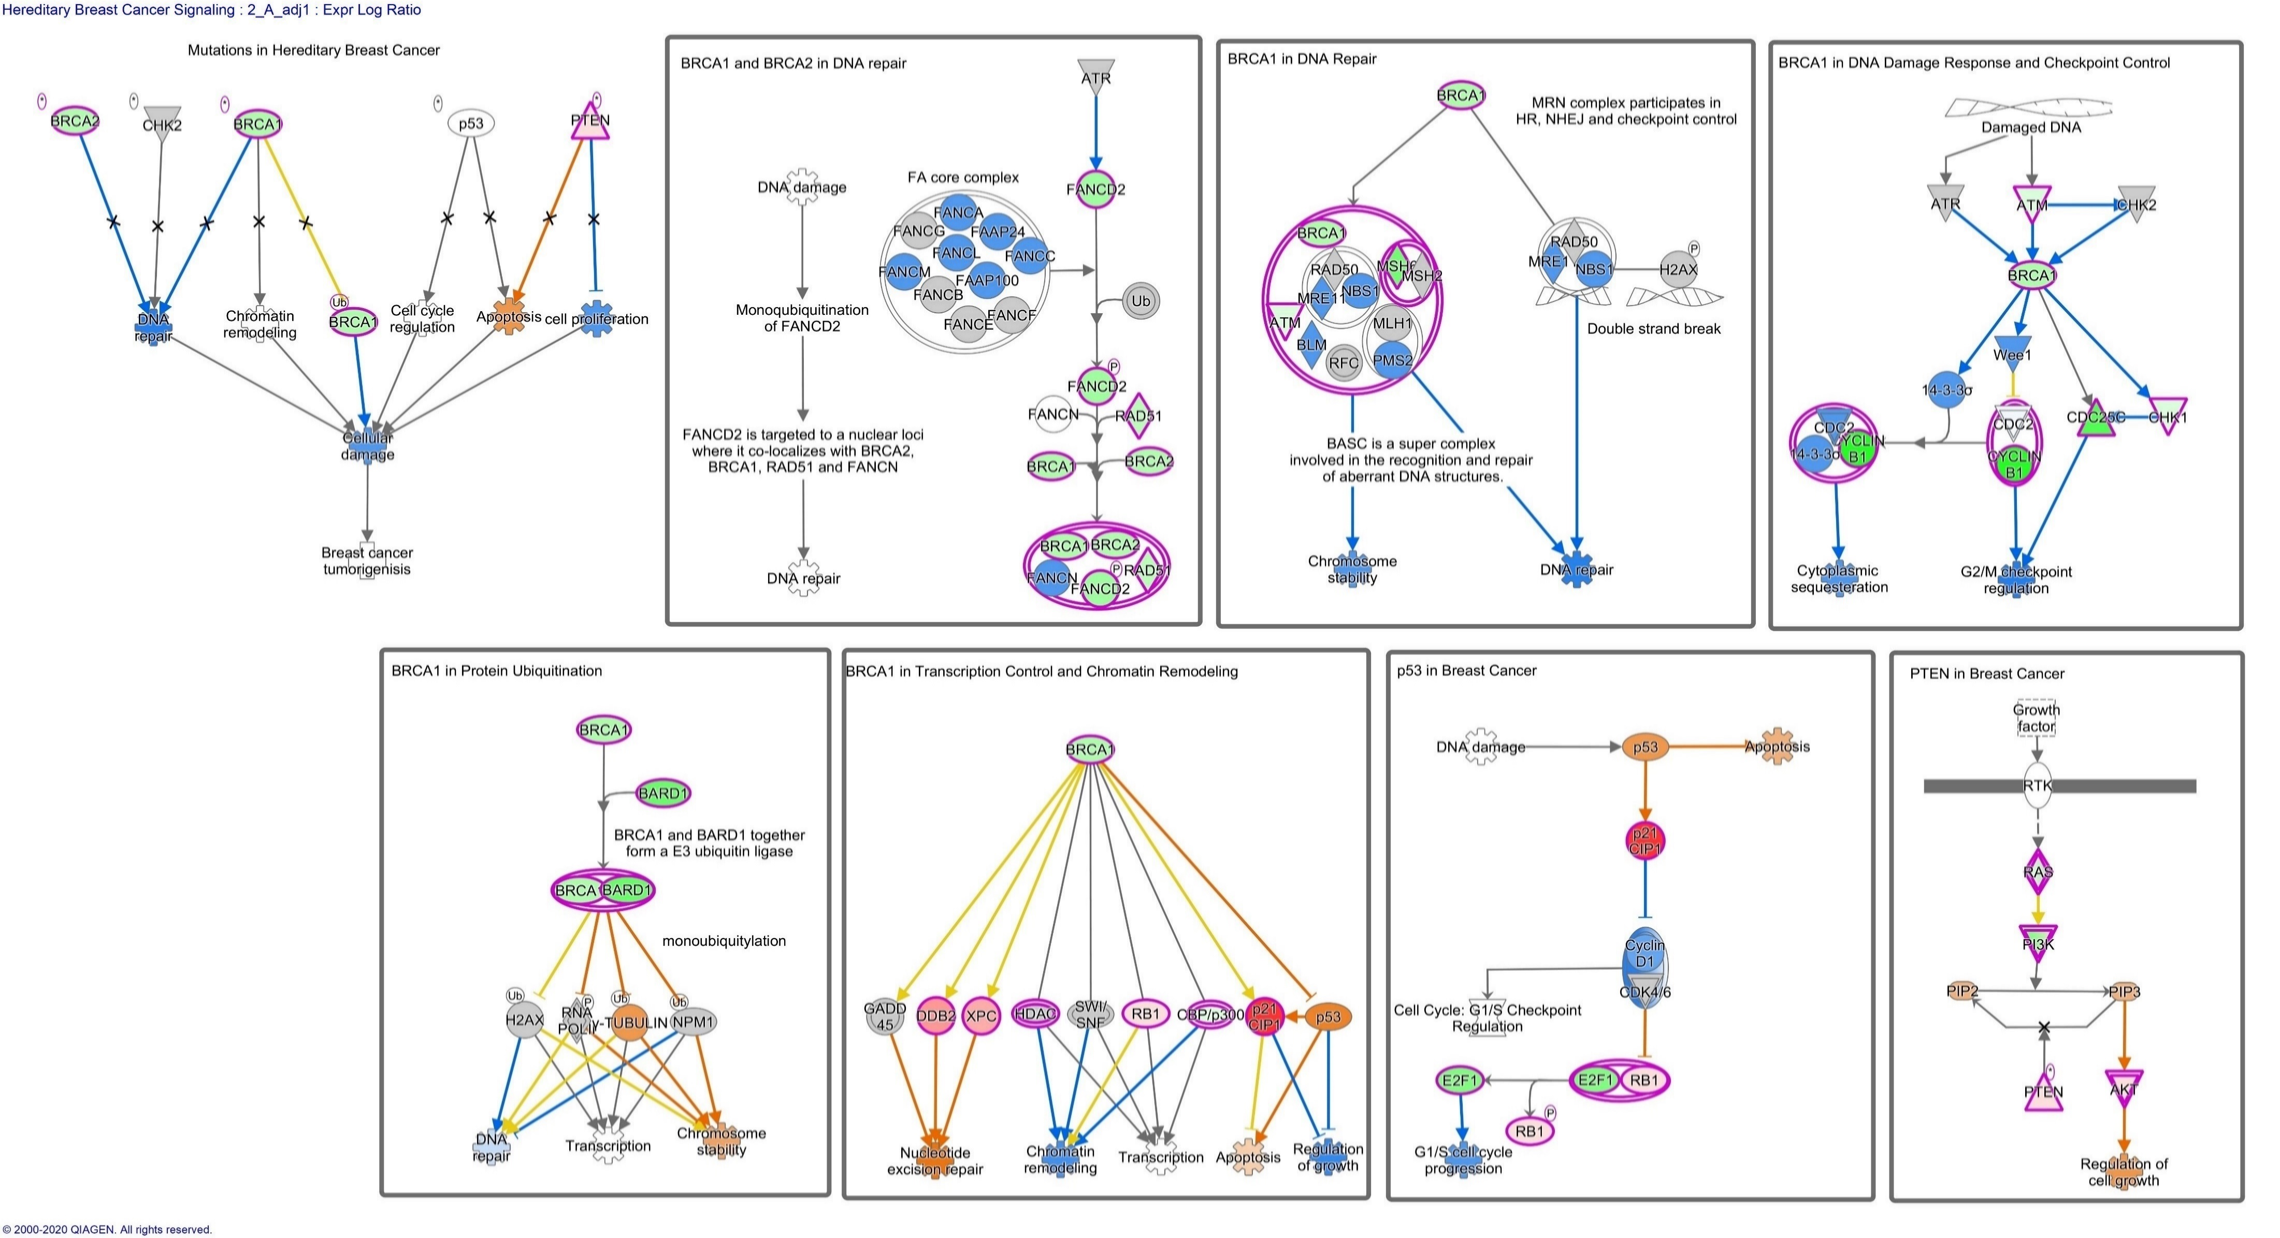
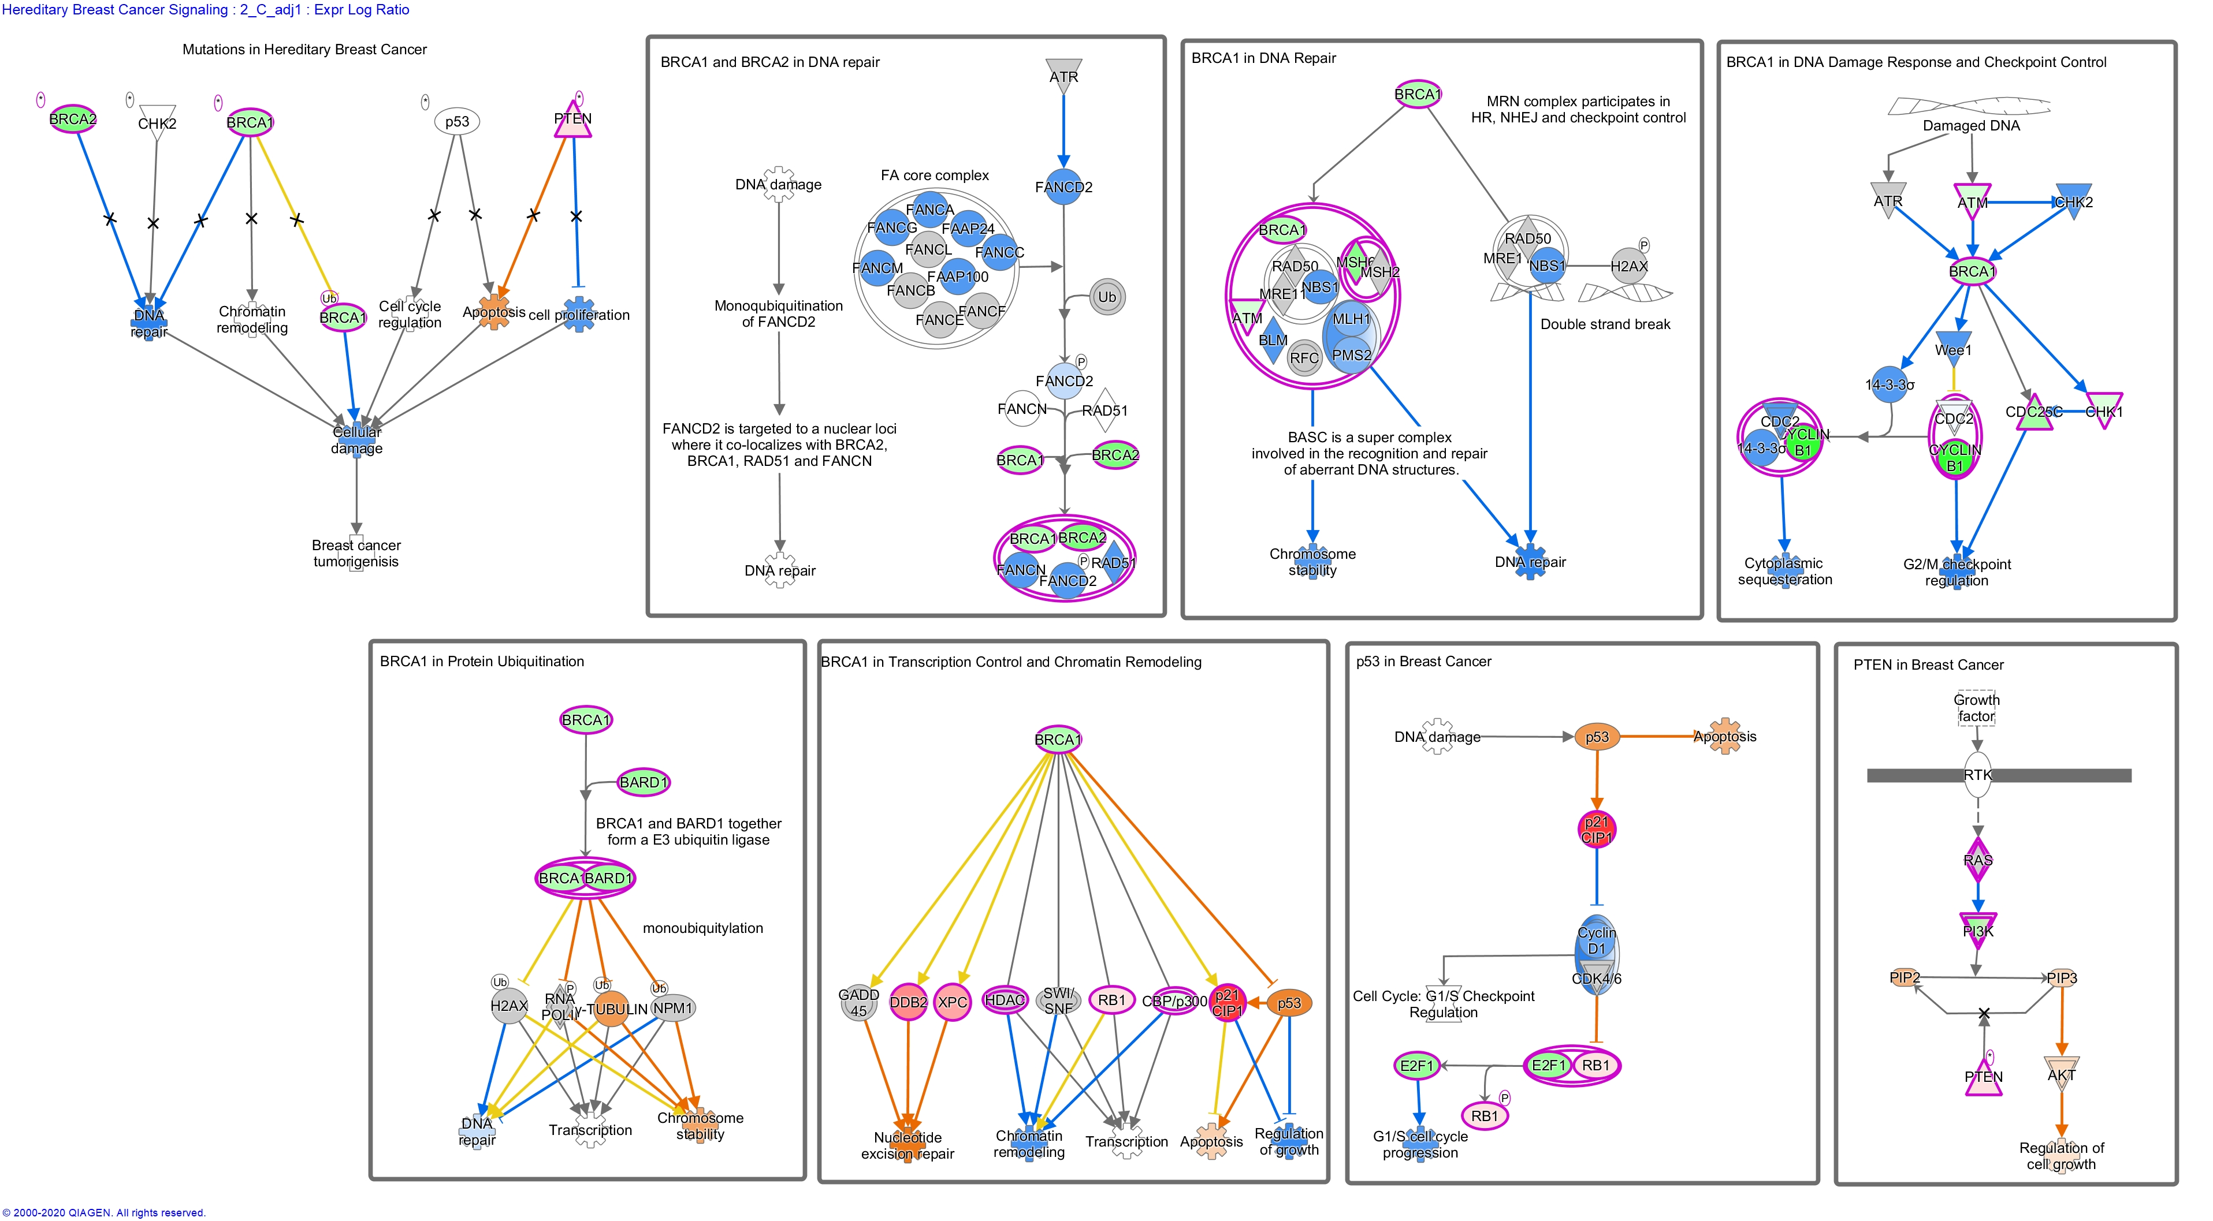
Additional File 8g
Molecule activity prediction using Ingenuity Pathway Analysis. Hereditary Breast Cancer Signaling after 2 Gray, model 1 (considering age at sampling and sex) in fibroblasts of donors with at least one second primary neoplasm (left) and cancer-free controls (right).

Slide 10
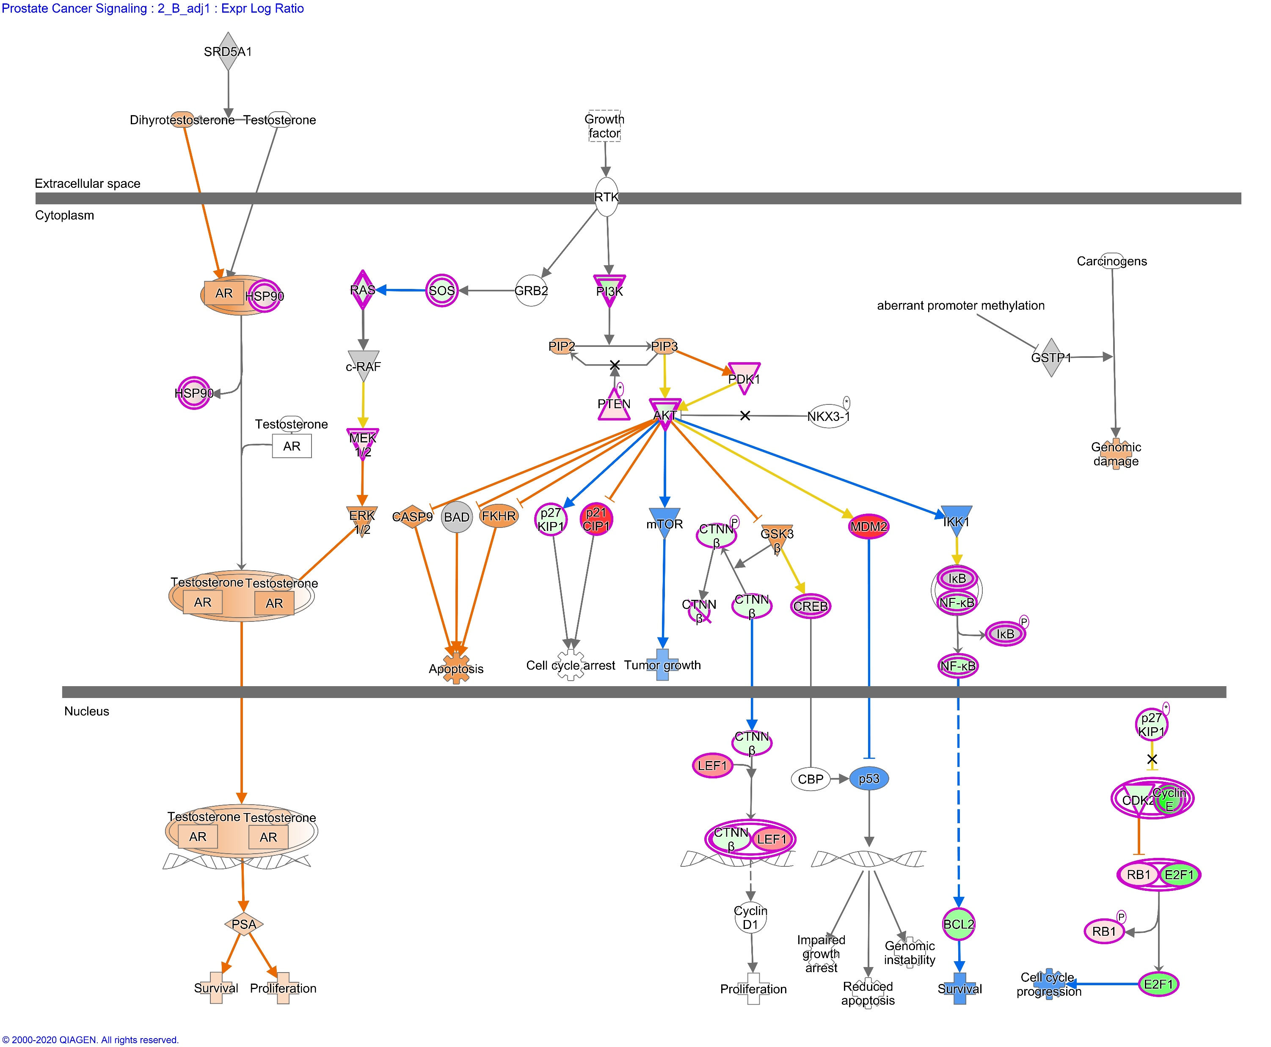
Additional File 8h
Molecule activity prediction using Ingenuity Pathway Analysis. Prostate Cancer Signaling after 2 Gray, model 1 (considering age at sampling and sex) in fibroblasts of childhood cancer survivors without a second neoplasm.

