Slide 1
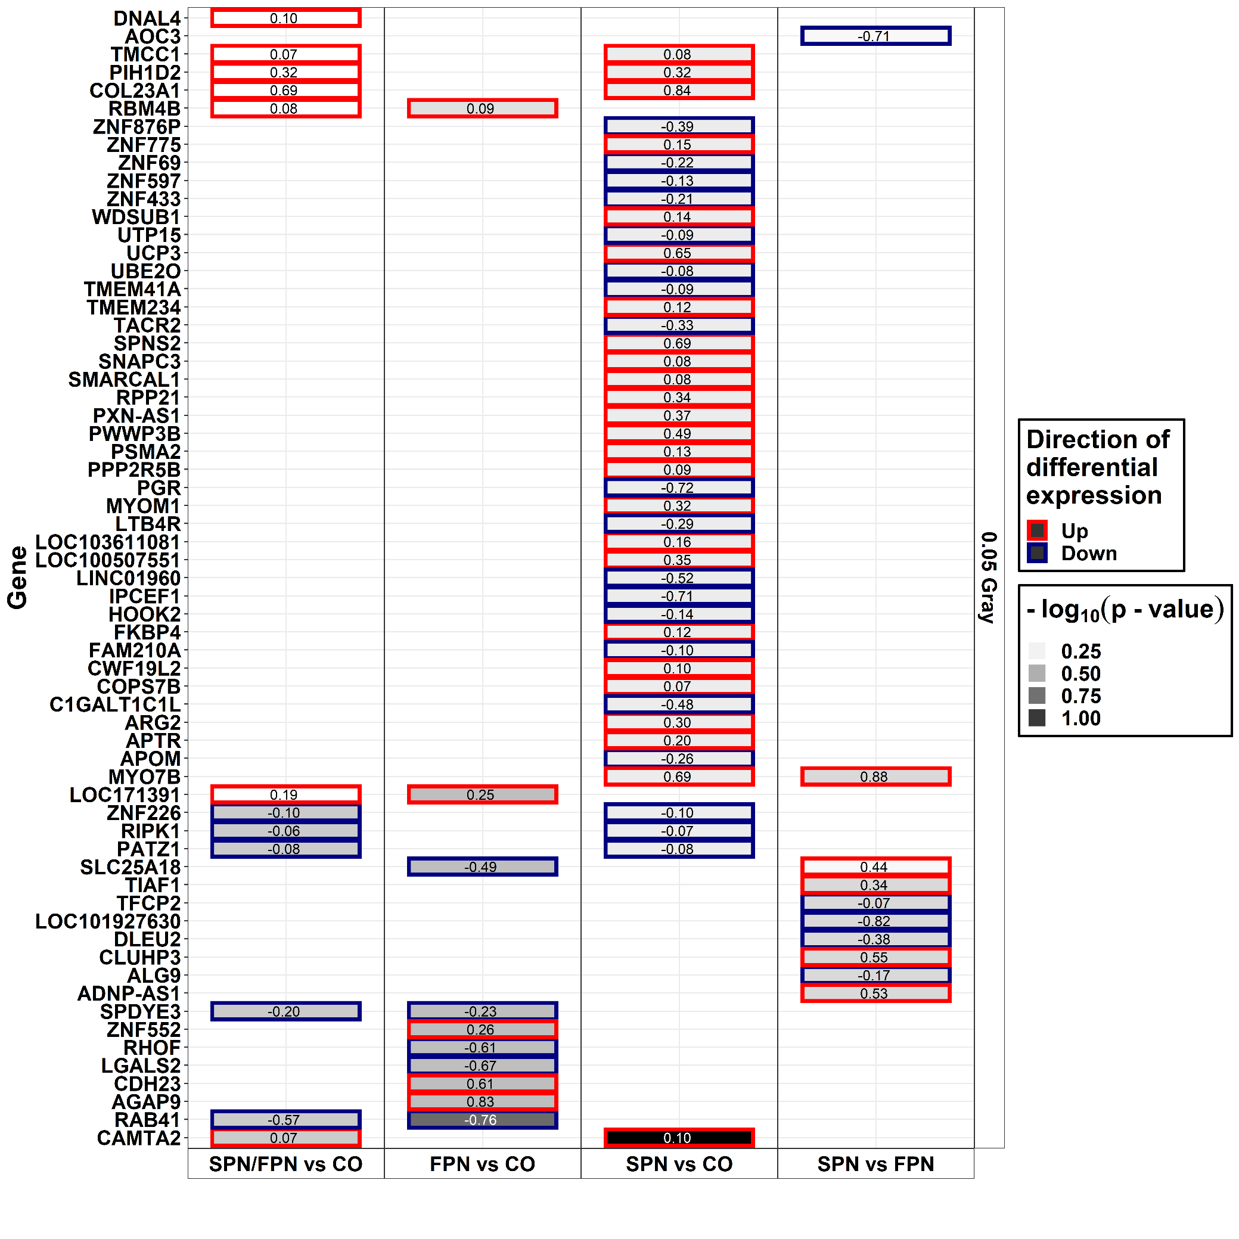
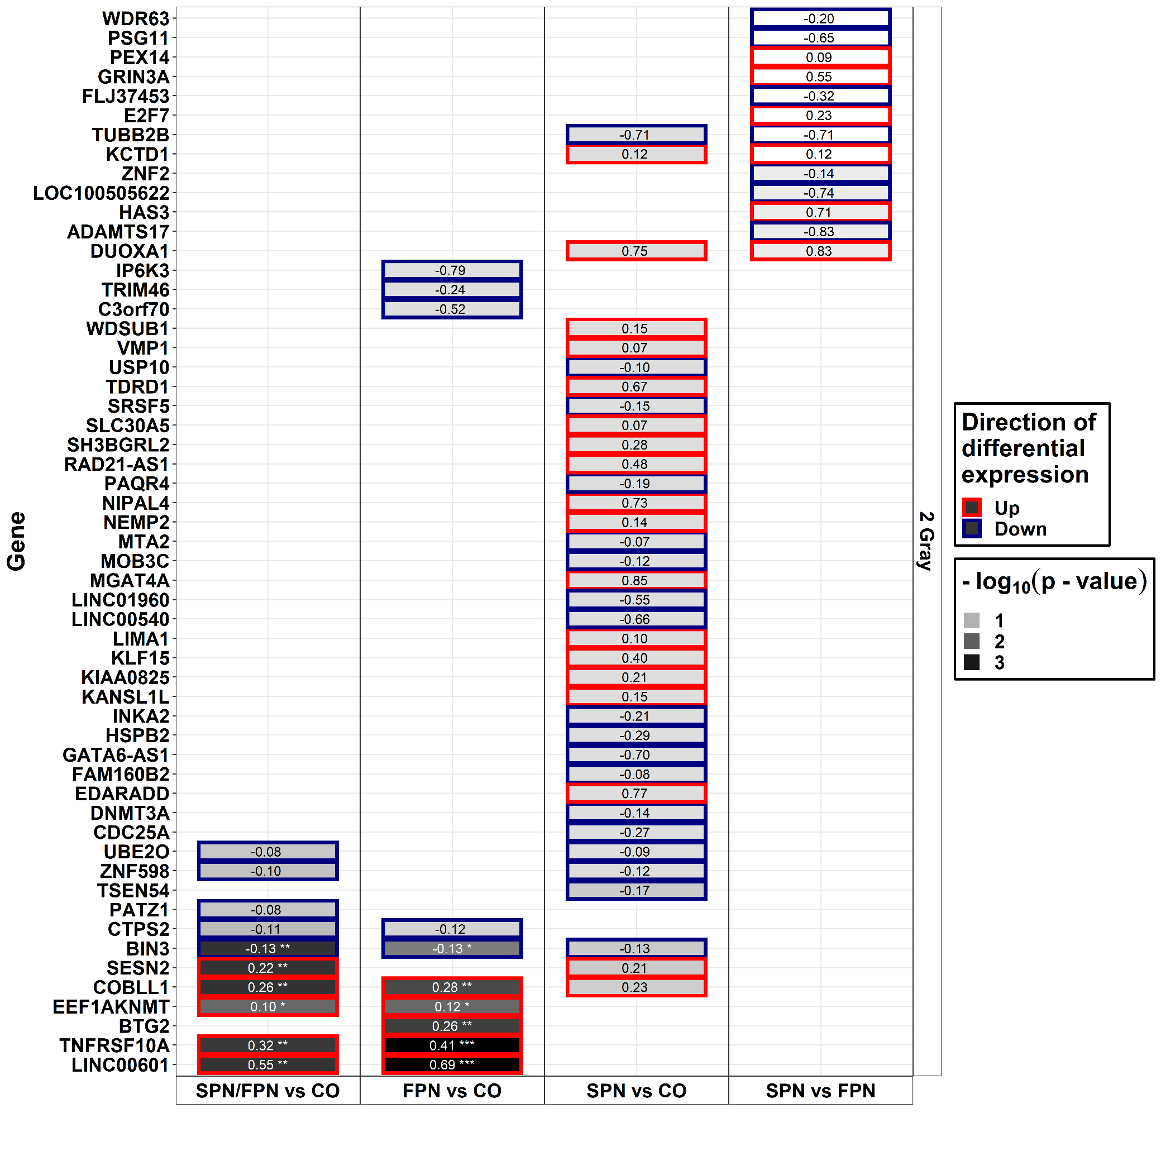
N1/N2+ vs N0
N1 vs N0
N2+ vs N0
N2+ vs N1
N1/N2+ vs N0
N1 vs N0
N2+ vs N0
N2+ vs N1
Additional File 10a: Heat maps displaying p-value and log₂ fold-change of the top 5 genes per radiation dose, direction of log₂ fold-change per group-wise comparison for expression models including group-dose interaction (with regard to p-value). Log₂ fold-change values can be found inside the tiles. Only the results for model 1 (considering age at sampling and sex) are displayed. N0 = fibroblasts of cancer-free controls, N1 = fibroblasts of donors with a first primary neoplasm, N2+ = fibroblasts of donors with at least one second primary neoplasm. * p-value < 0.05, ** p-value < 0.01, *** p-value < 0.001 (adjusted for false discovery rate).

Slide 2
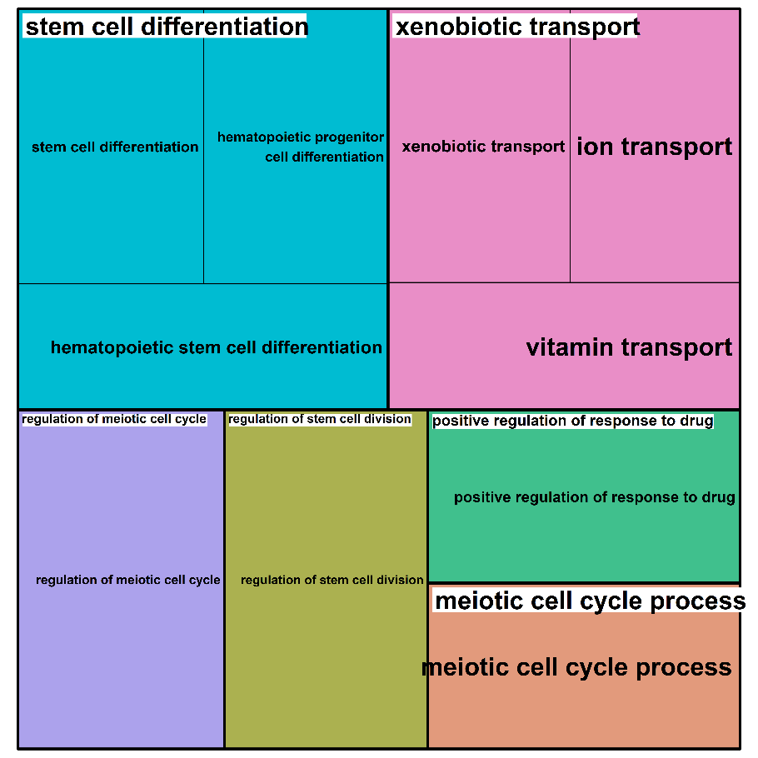
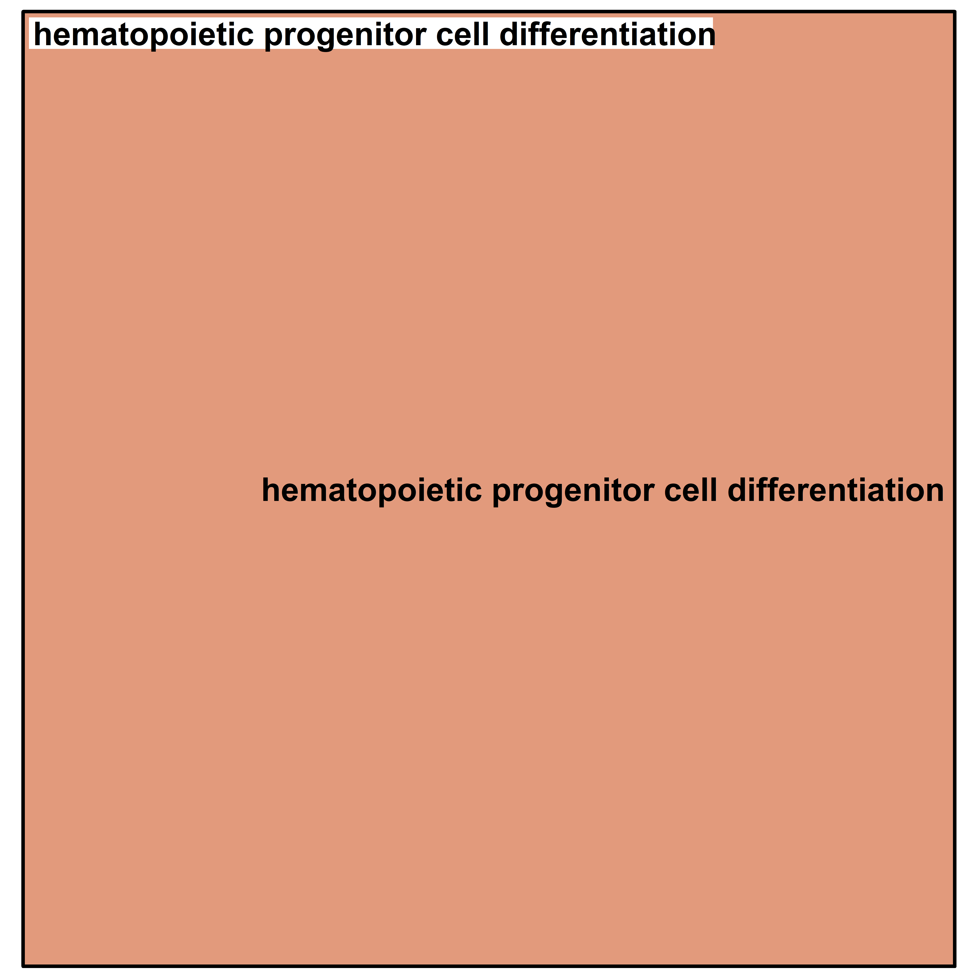
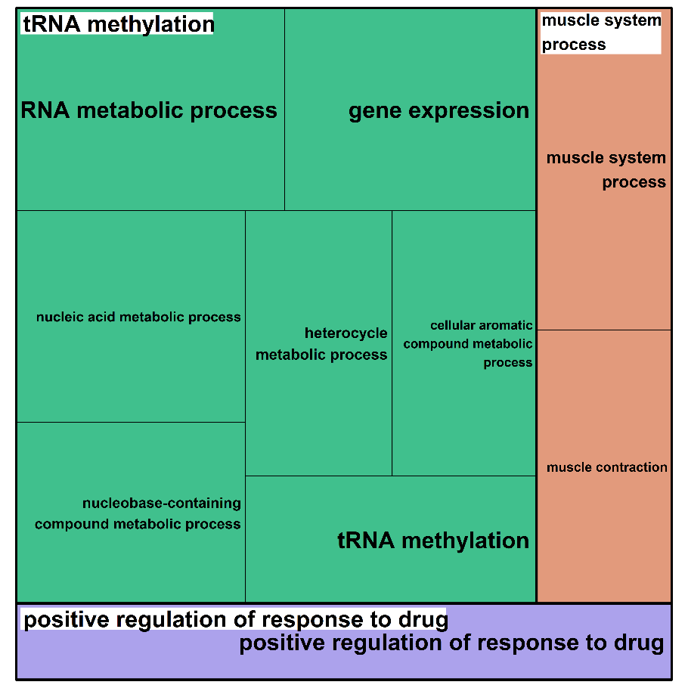
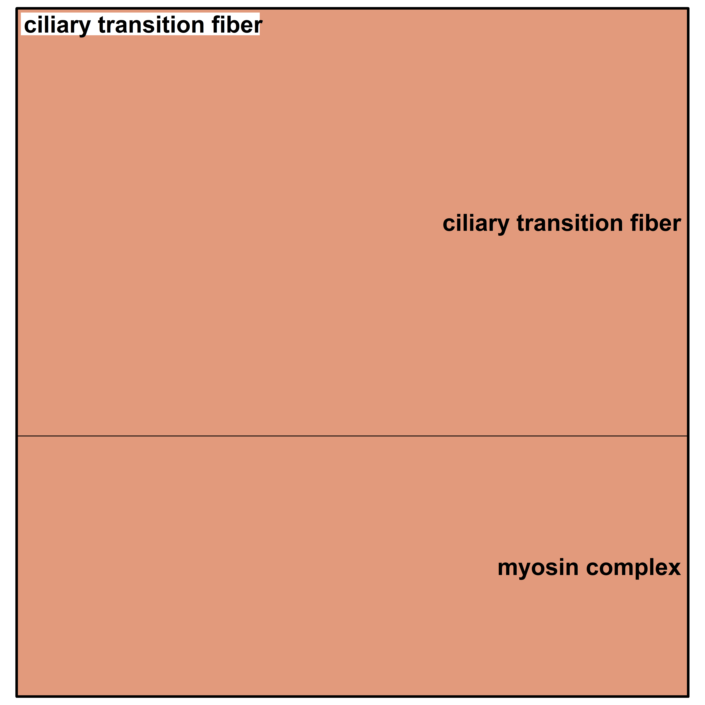
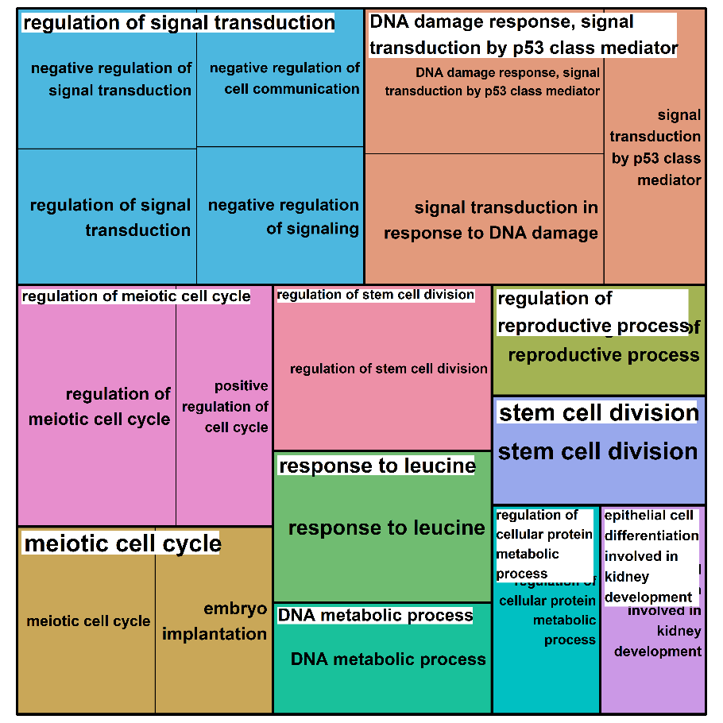
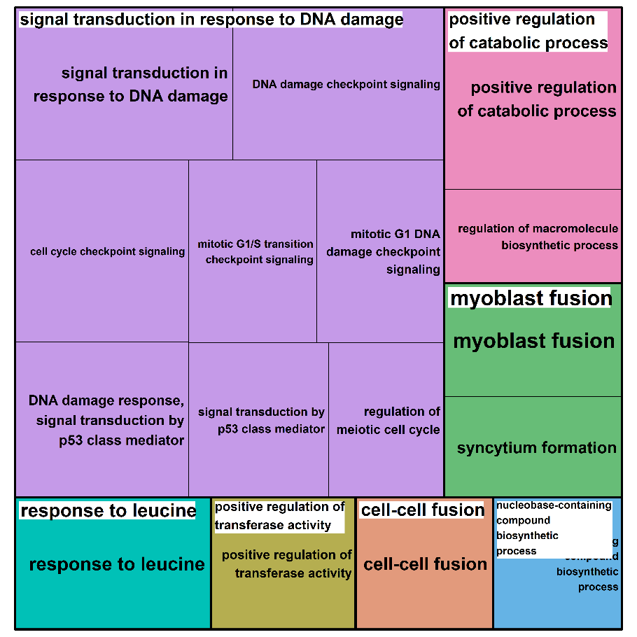
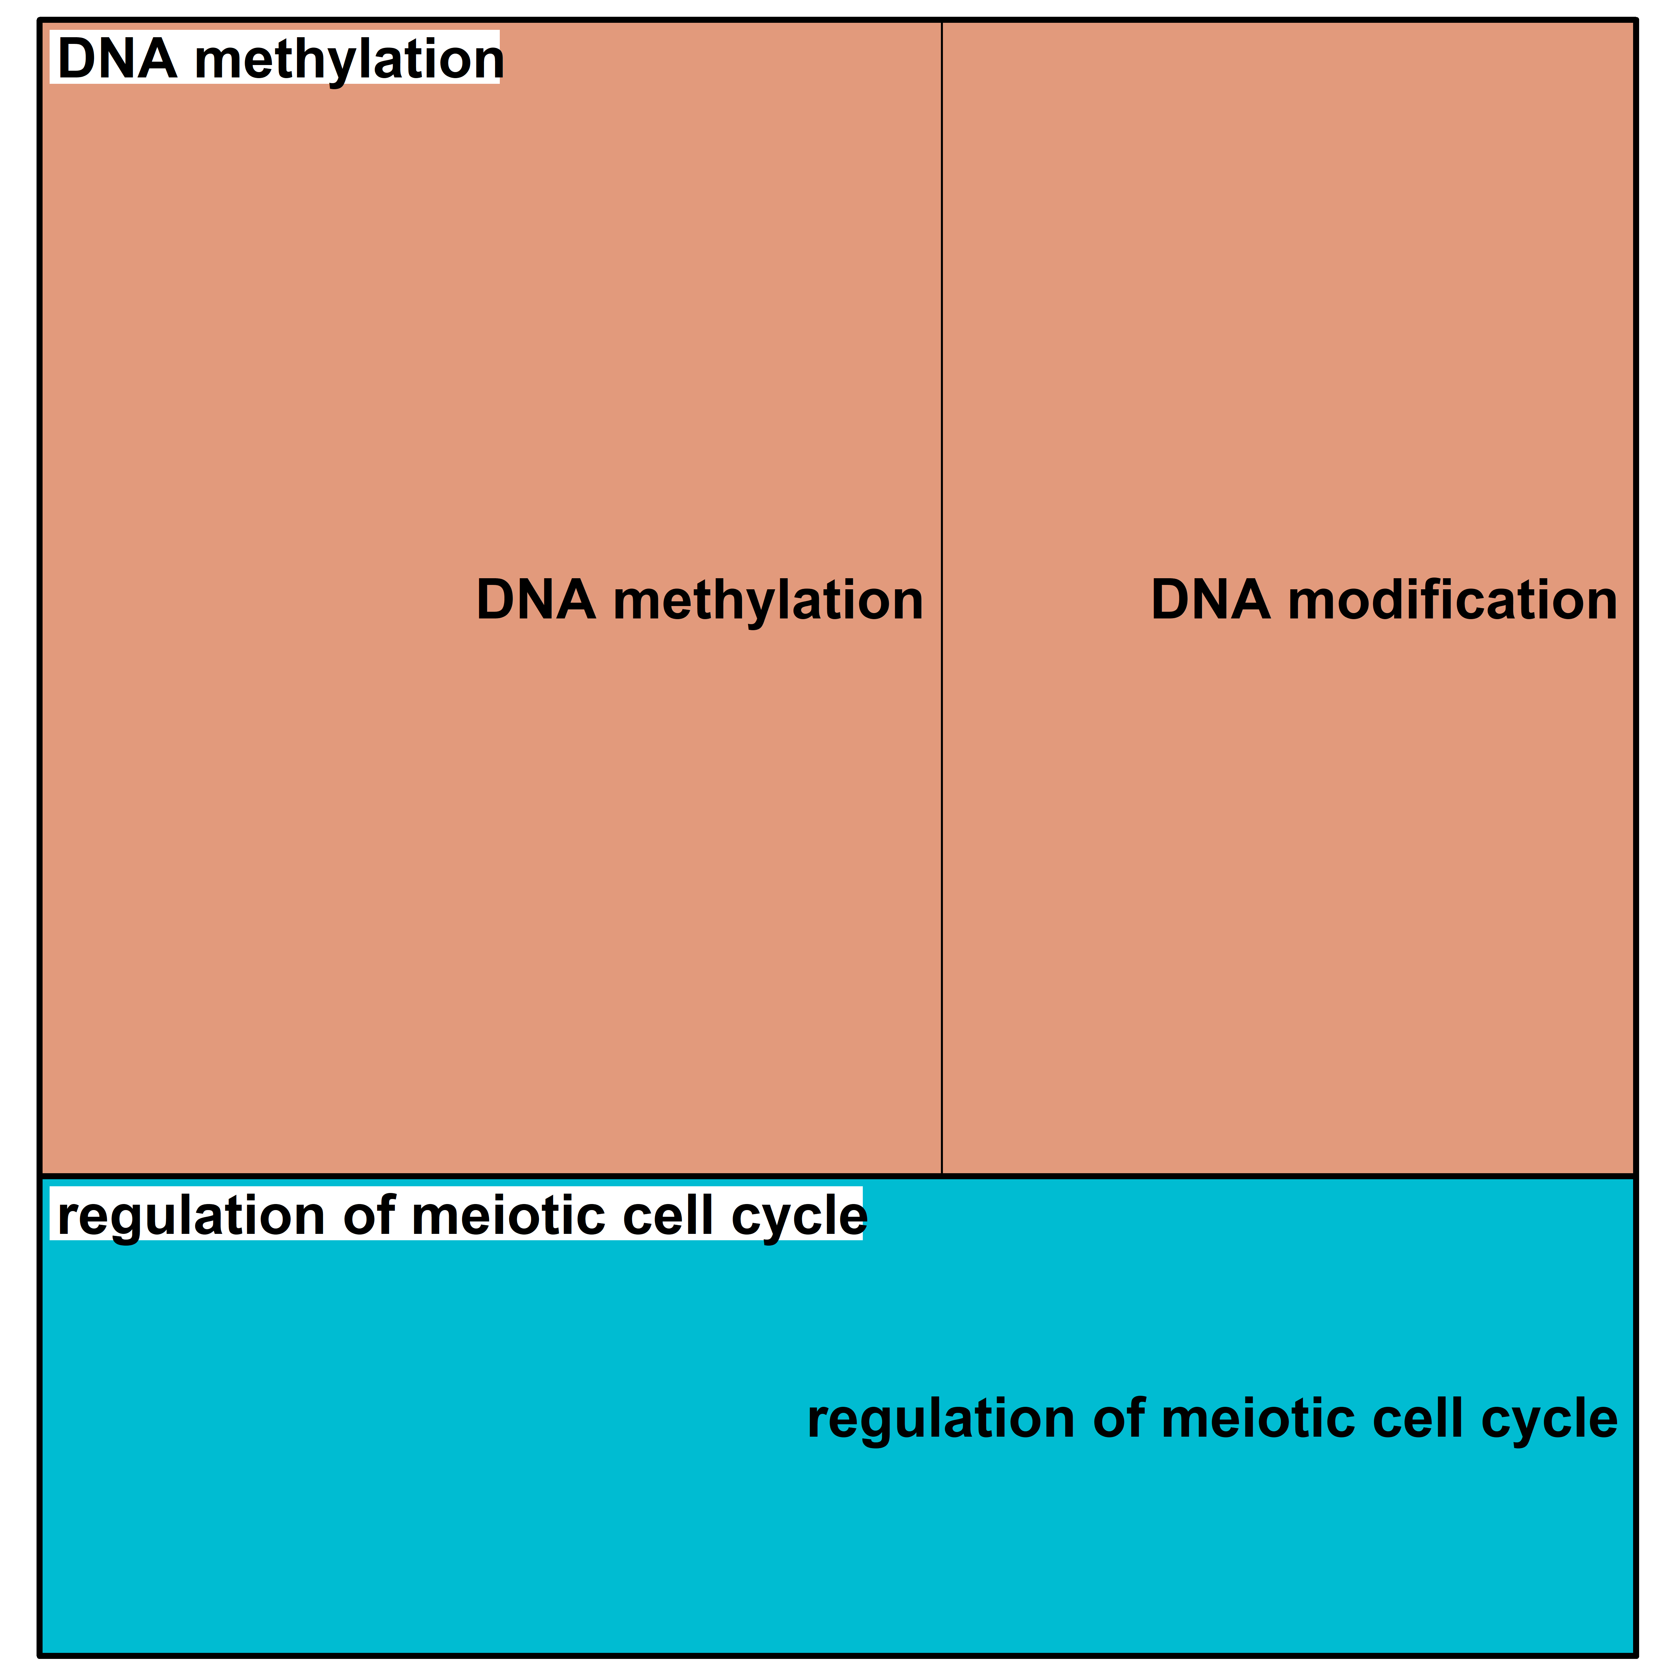
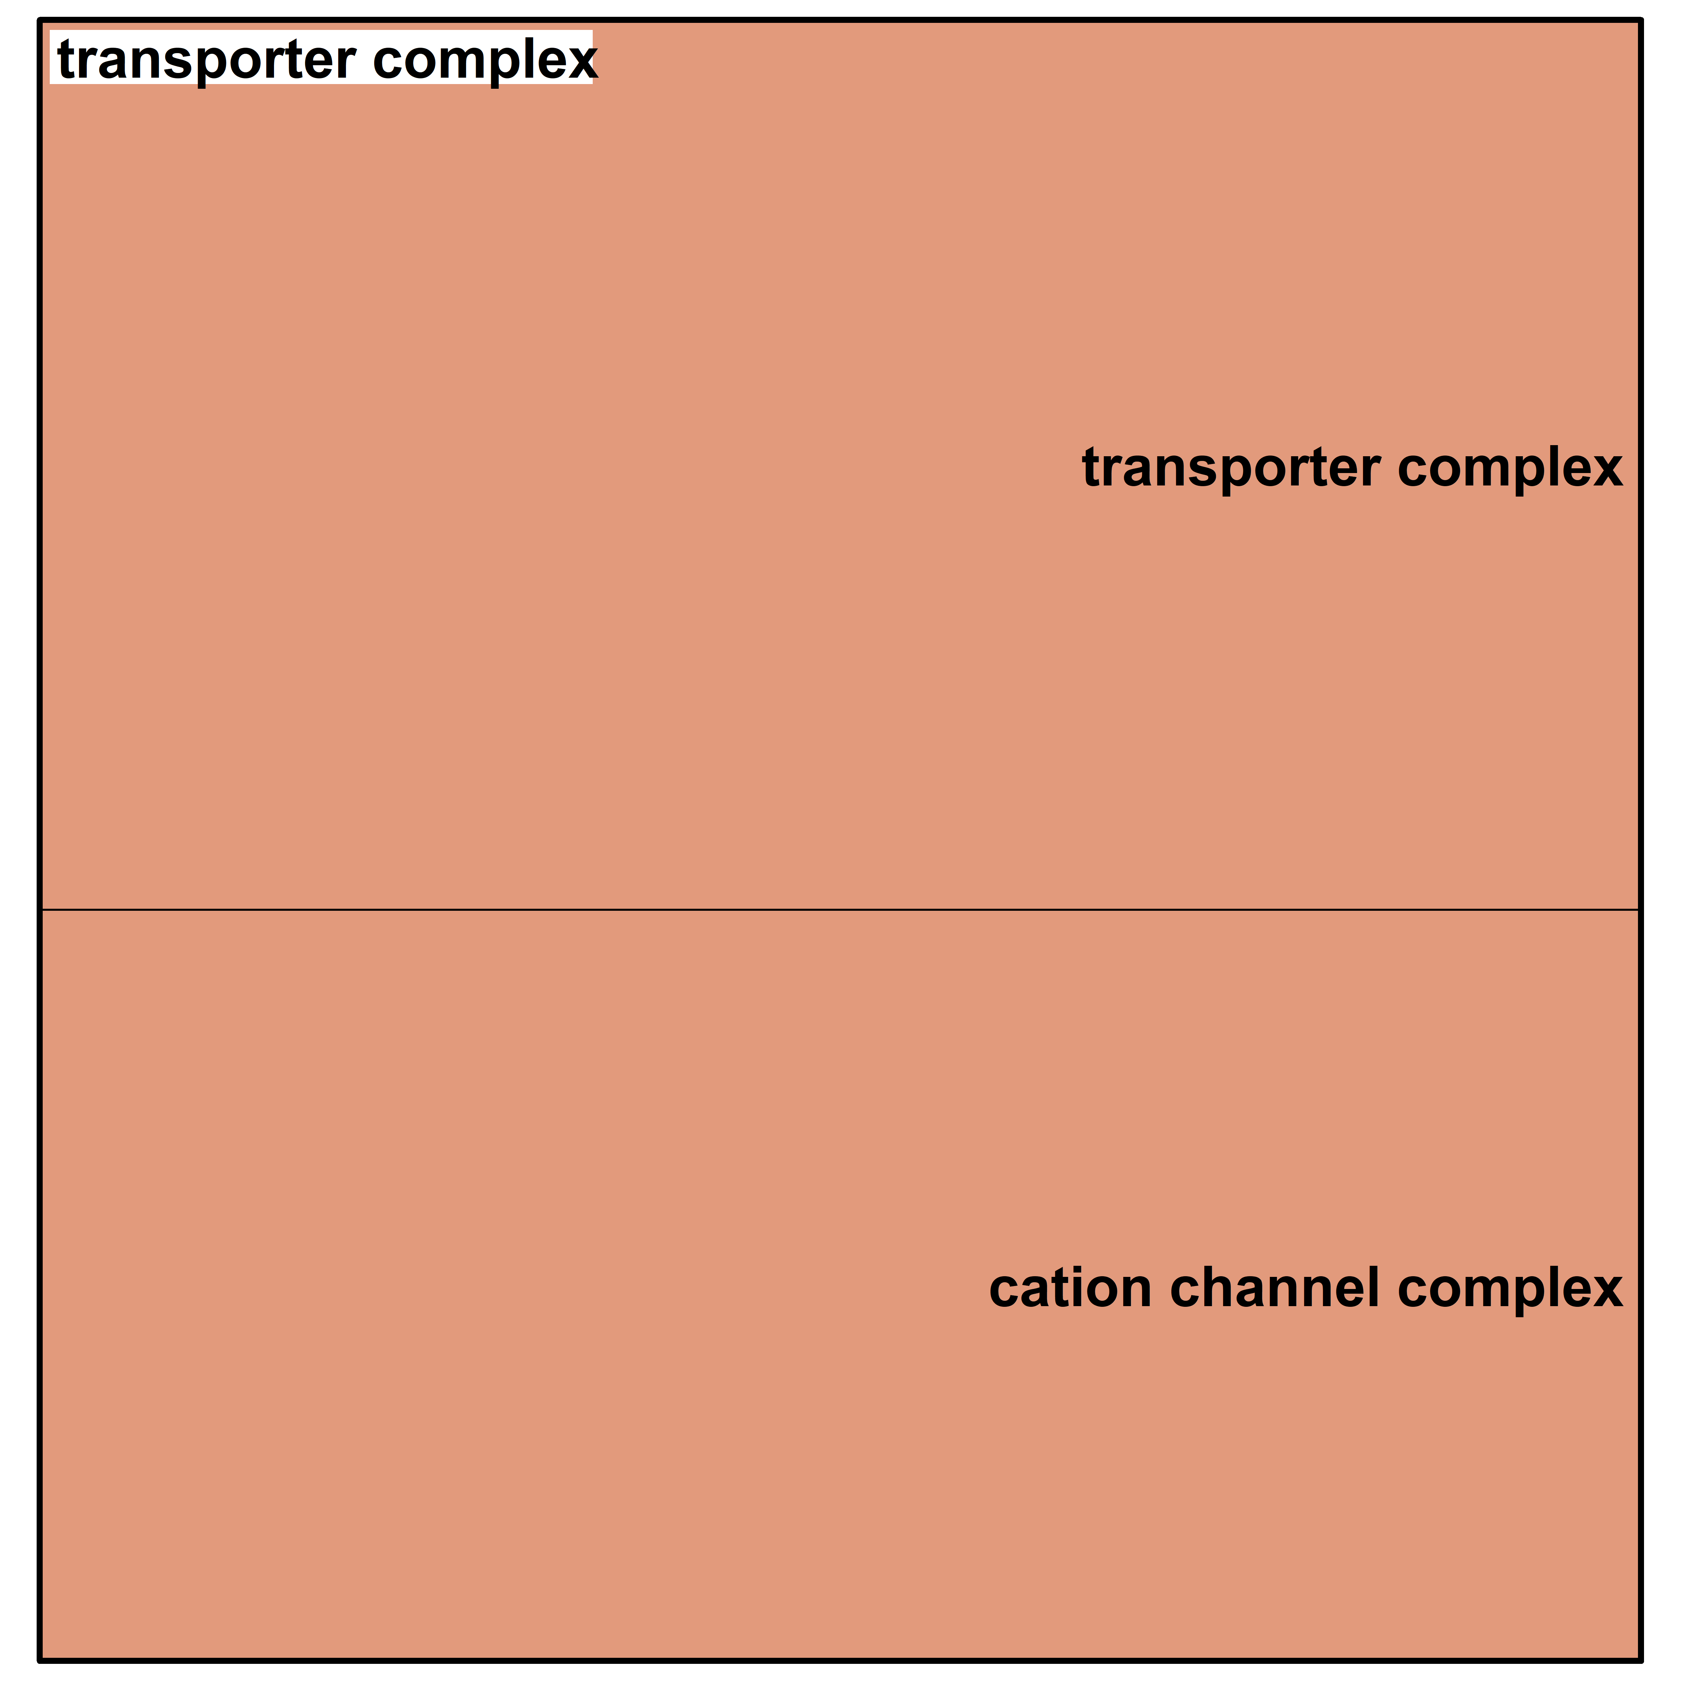
0.05 Gray
2 Gray
N1/N2+ compared to N0
N1 compared to N0
N2+ compared to N0
N2+ compared to N1
Additional File 10b: Tree maps displaying clustered top gene ontology terms for the top 50 genes (with regard to p-value)
for expression models including group-dose interaction (with regard to p-value) for each group-wise comparison. Only the results for model 1 (considering age and sex) are displayed. N0 = fibroblasts of cancer-free controls, N1 = fibroblasts of donors with a first primary neoplasm, N2+ = fibroblasts of donors with at least one second primary neoplasm.

